Slide 1
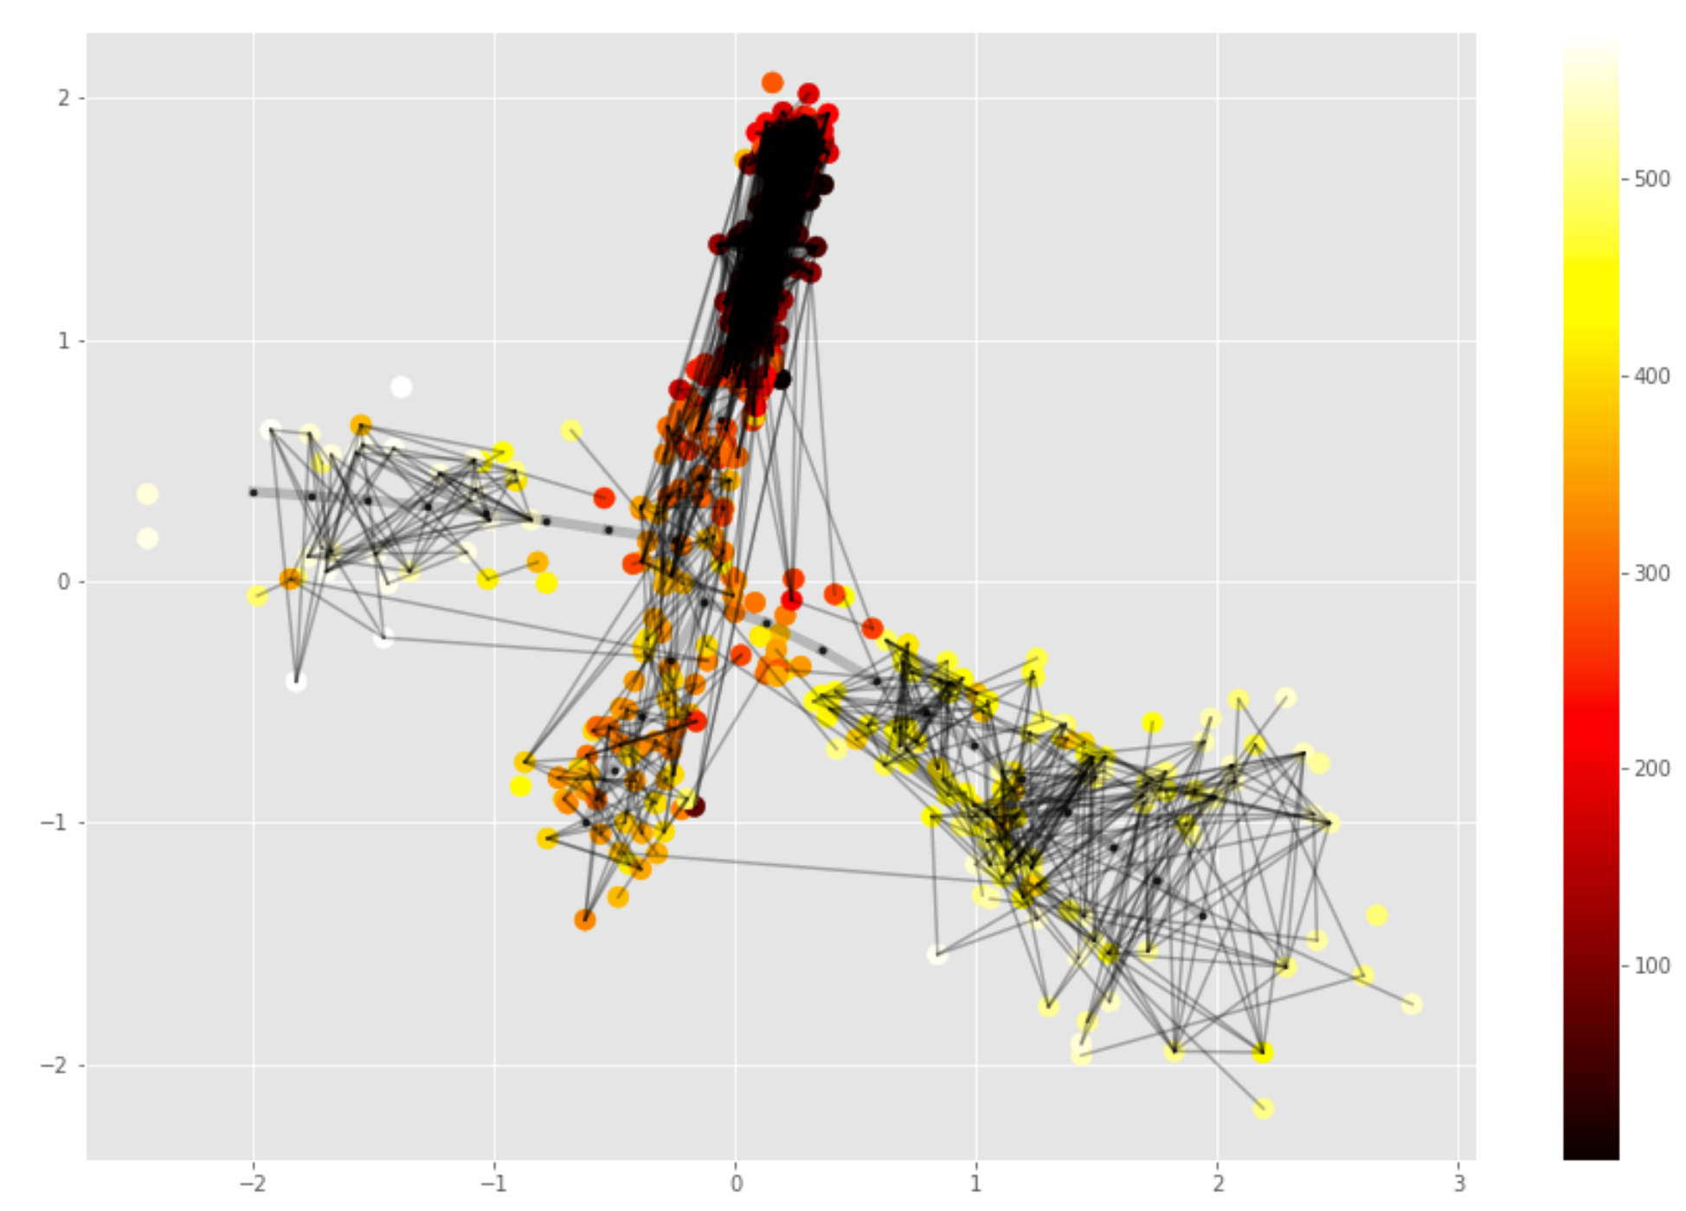
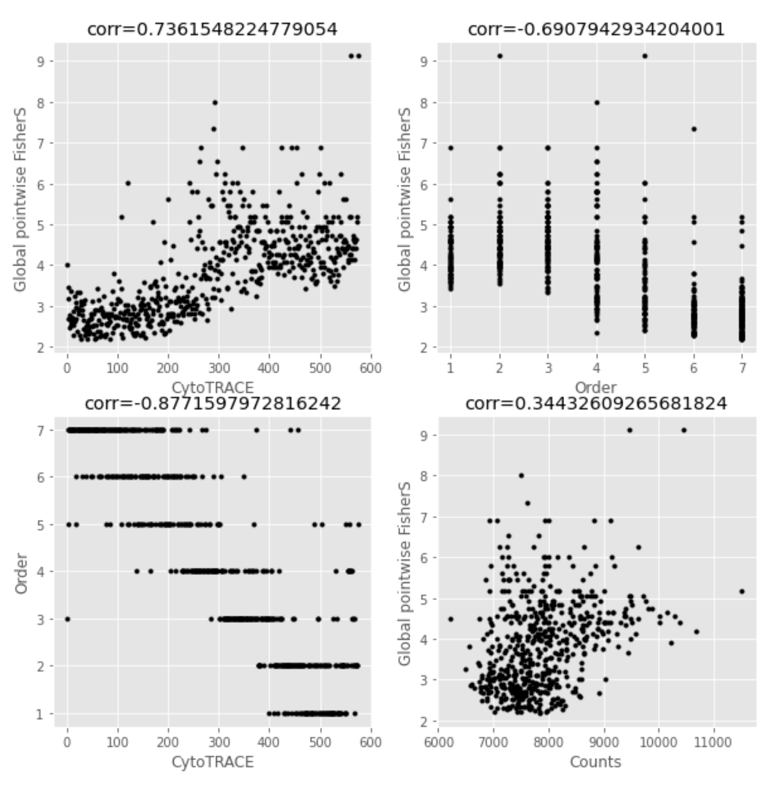
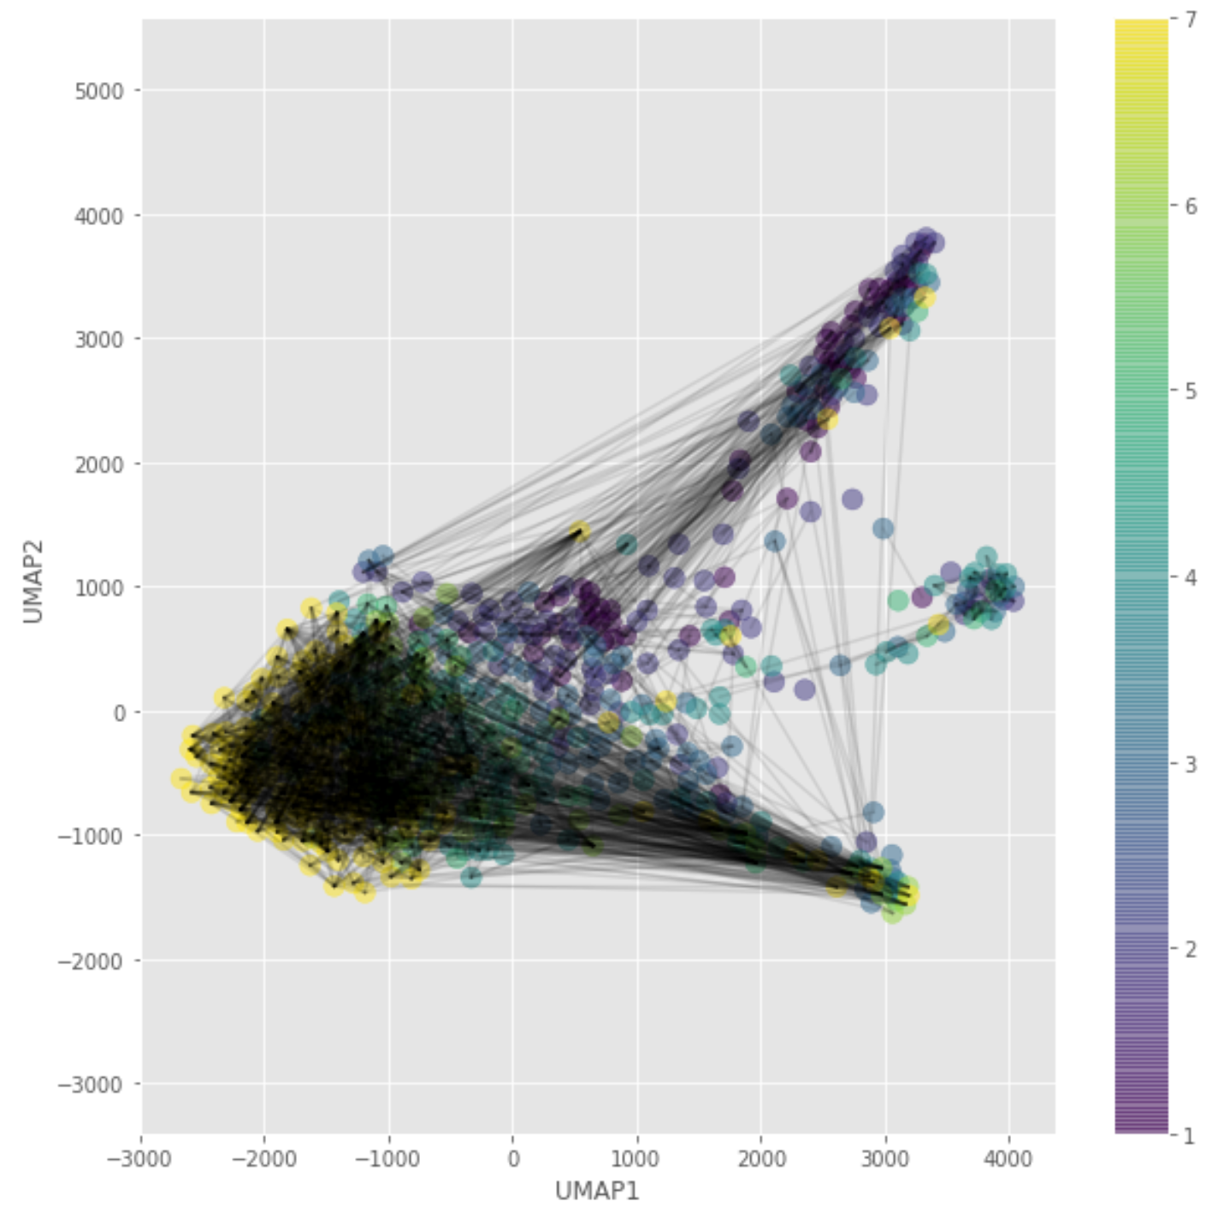
GSE87375_38

Slide 2
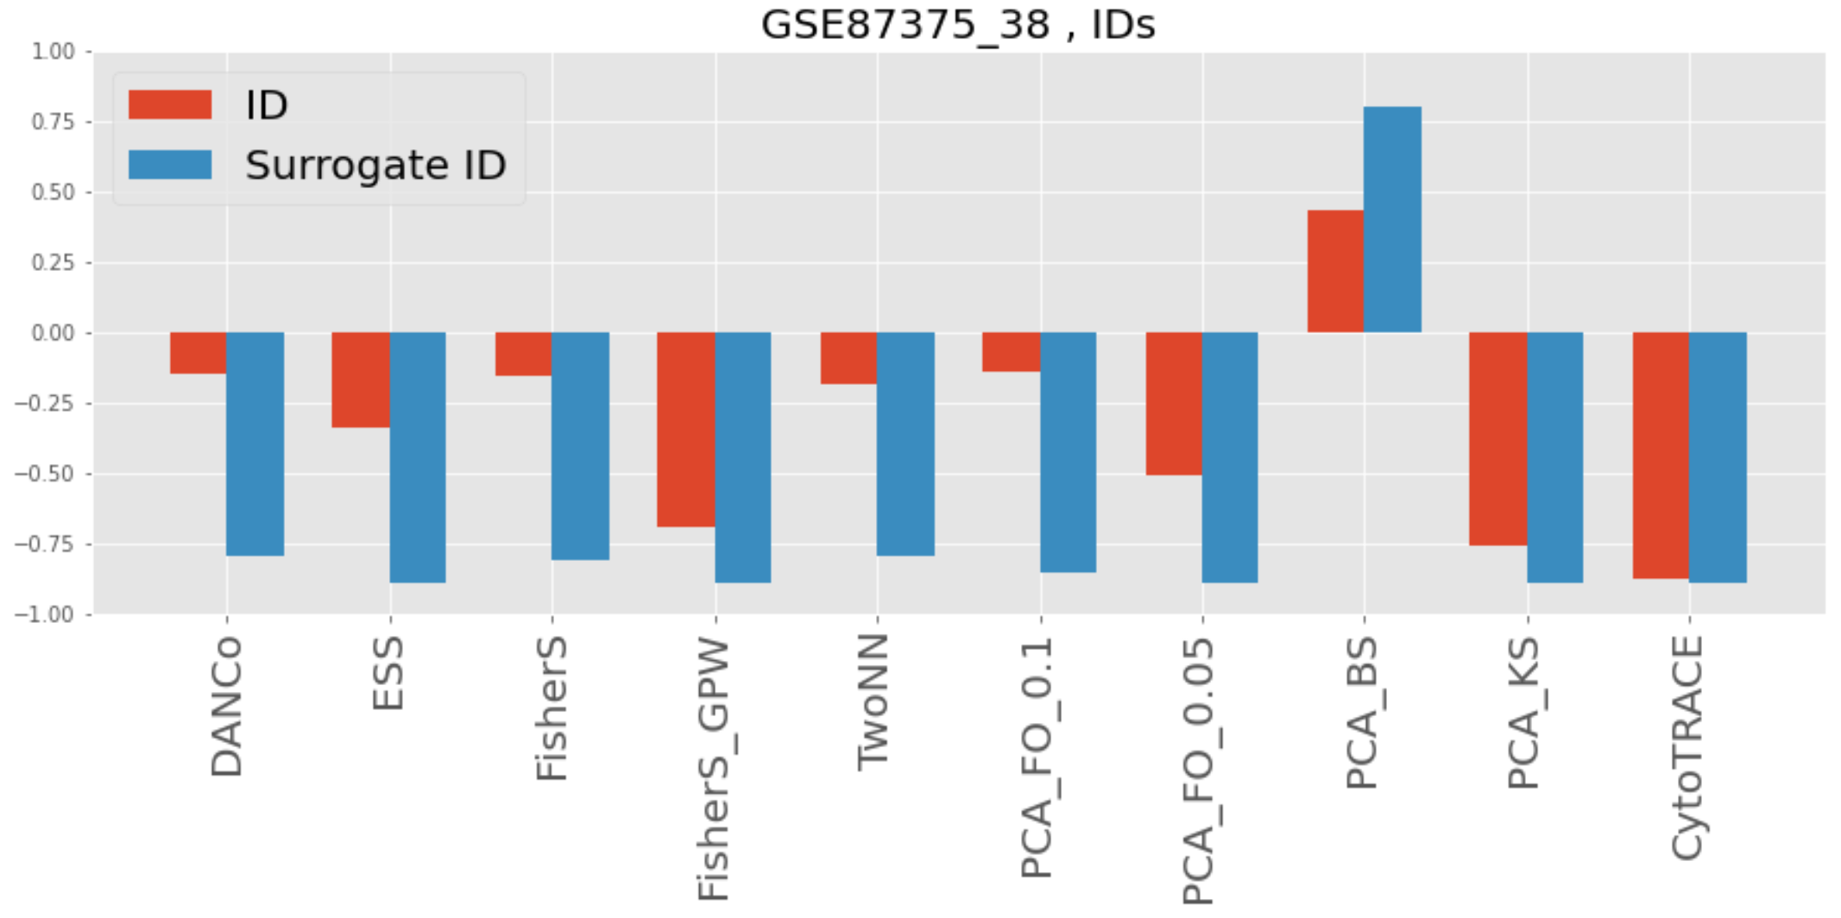
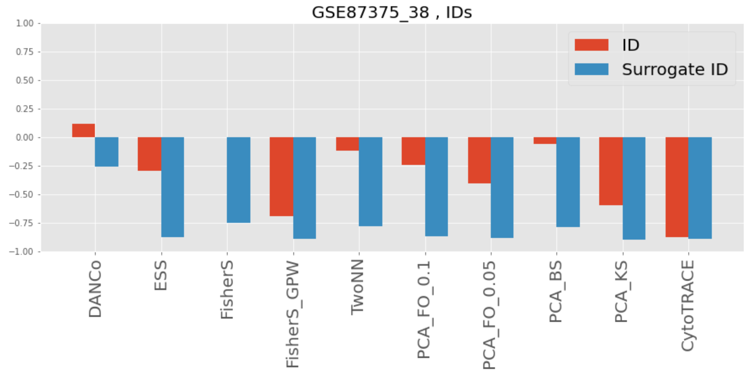
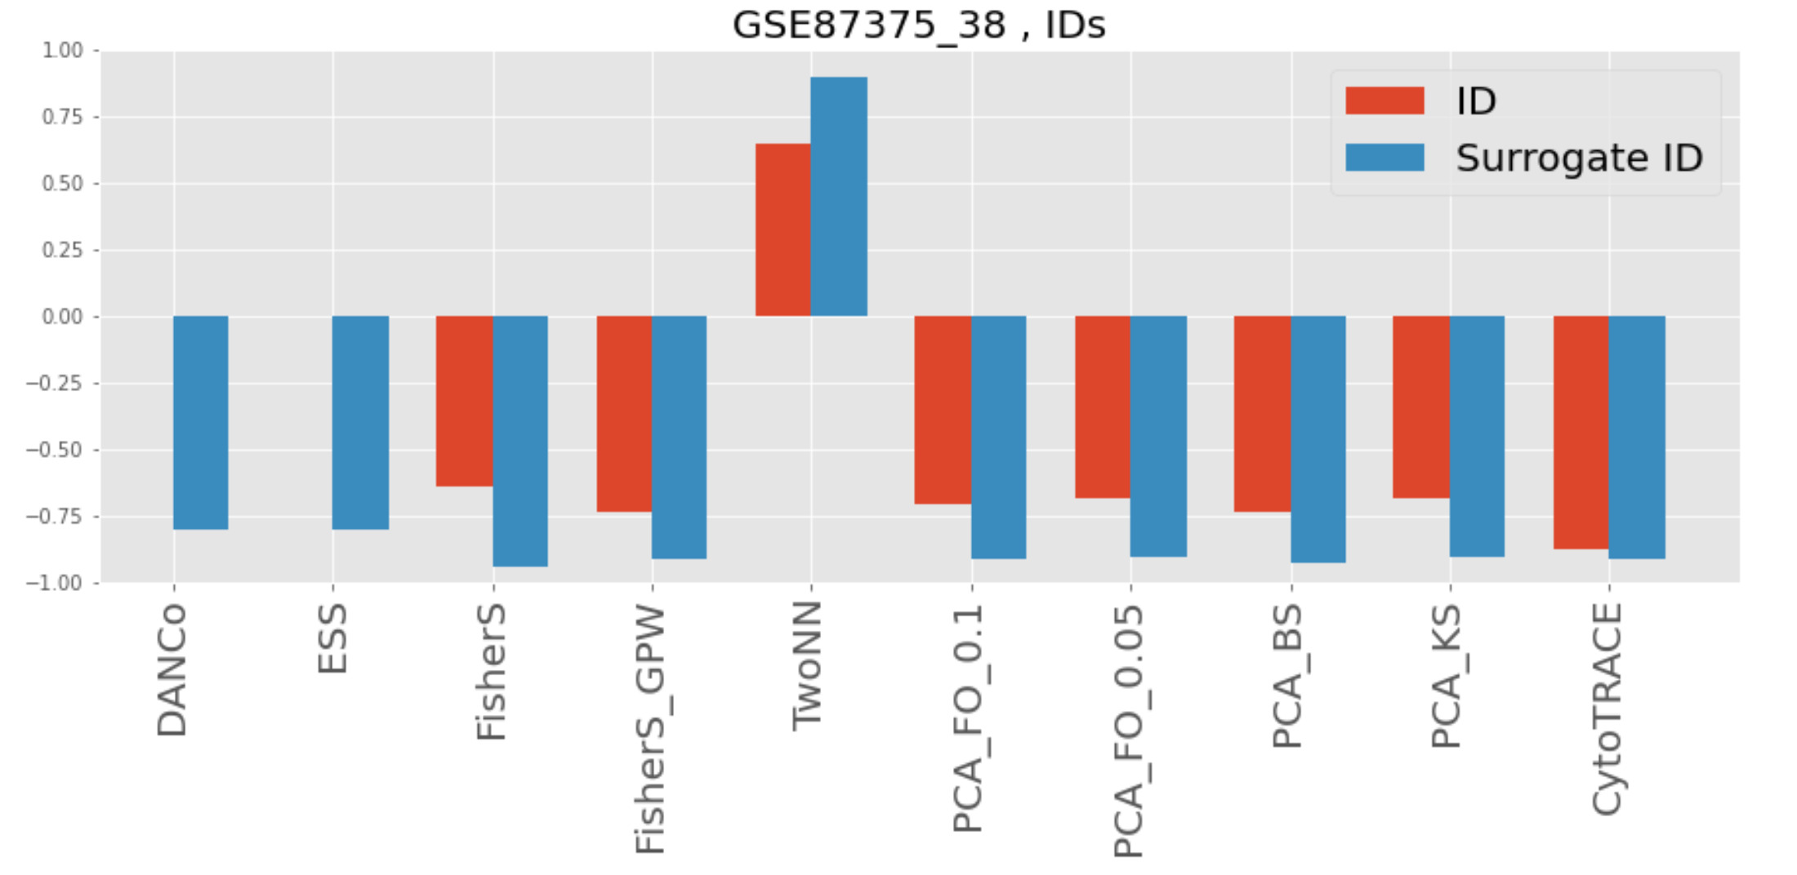
GSE87375_38, correlation with order variable
n_neighbours = 100
n_neighbours = 10% = 57
n_neighbours = 10% = 57, with pooling

Slide 3
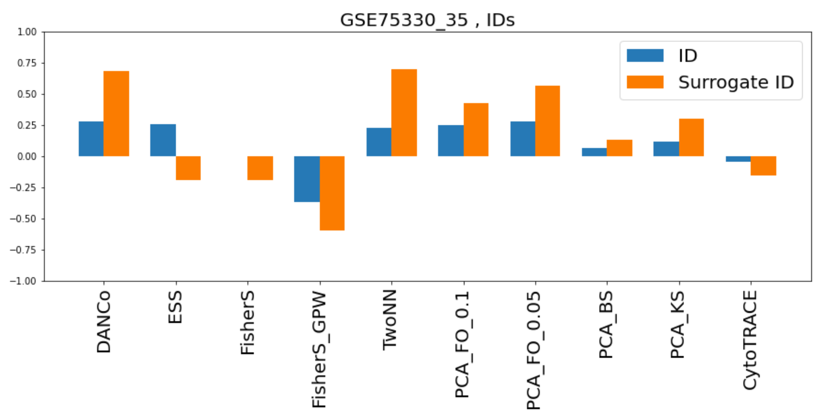
GSE75330_35, Oligodendrocyte phenotypes (C1)
Finally, the remaining dataset, which describes the differentiation of oligodendrocyte
precursors into myelin-forming cells (70) (‘Oligodendrocyte phenotypes (C1)’; table S1), is
poorly ordered by all evaluated methods and gene sets (all rho < 0.4). Whether this result
reflects a dataset-specific technical problem or features of developmental biology that are not
adequately captured by the methods and gene sets that we evaluated remains unclear.

Slide 4
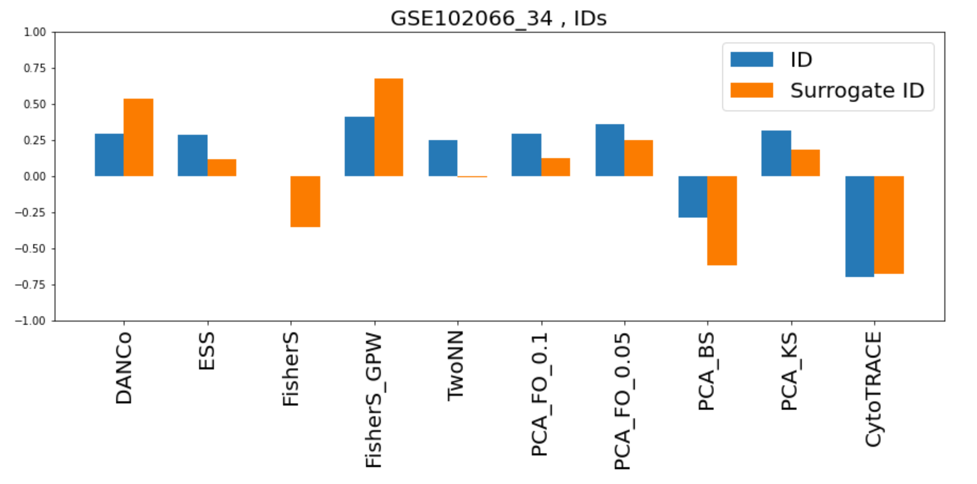
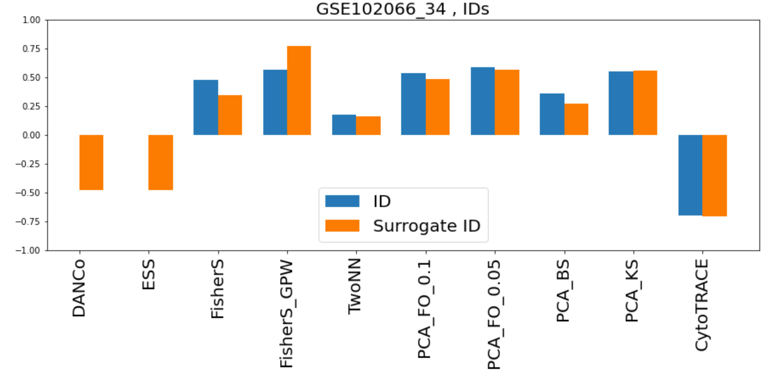
GSE102066_34, In vitro NPCs (C1), example of failure wrt CytoTRACE
With pooling
Reversed but not bad by absolute value!

Slide 5
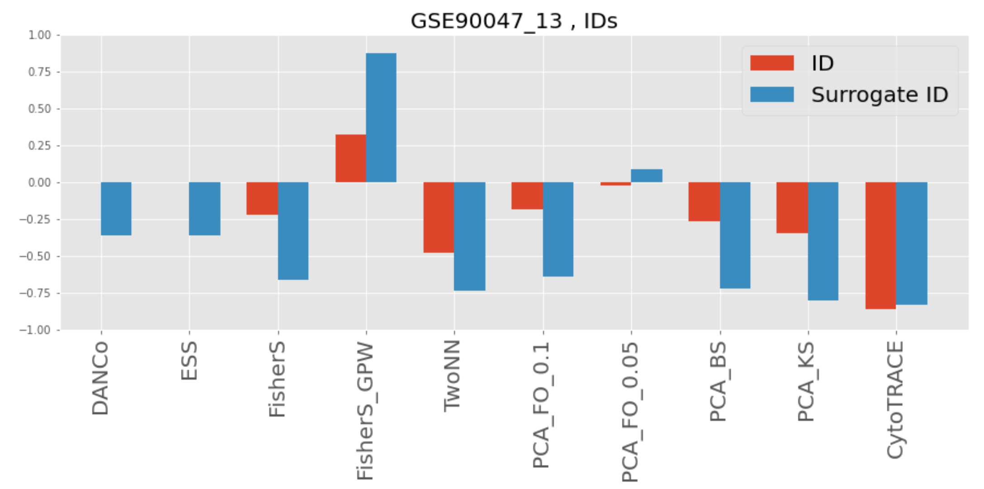
GSE90047_13, overall good but FisherS_GPW is reverted

Slide 6
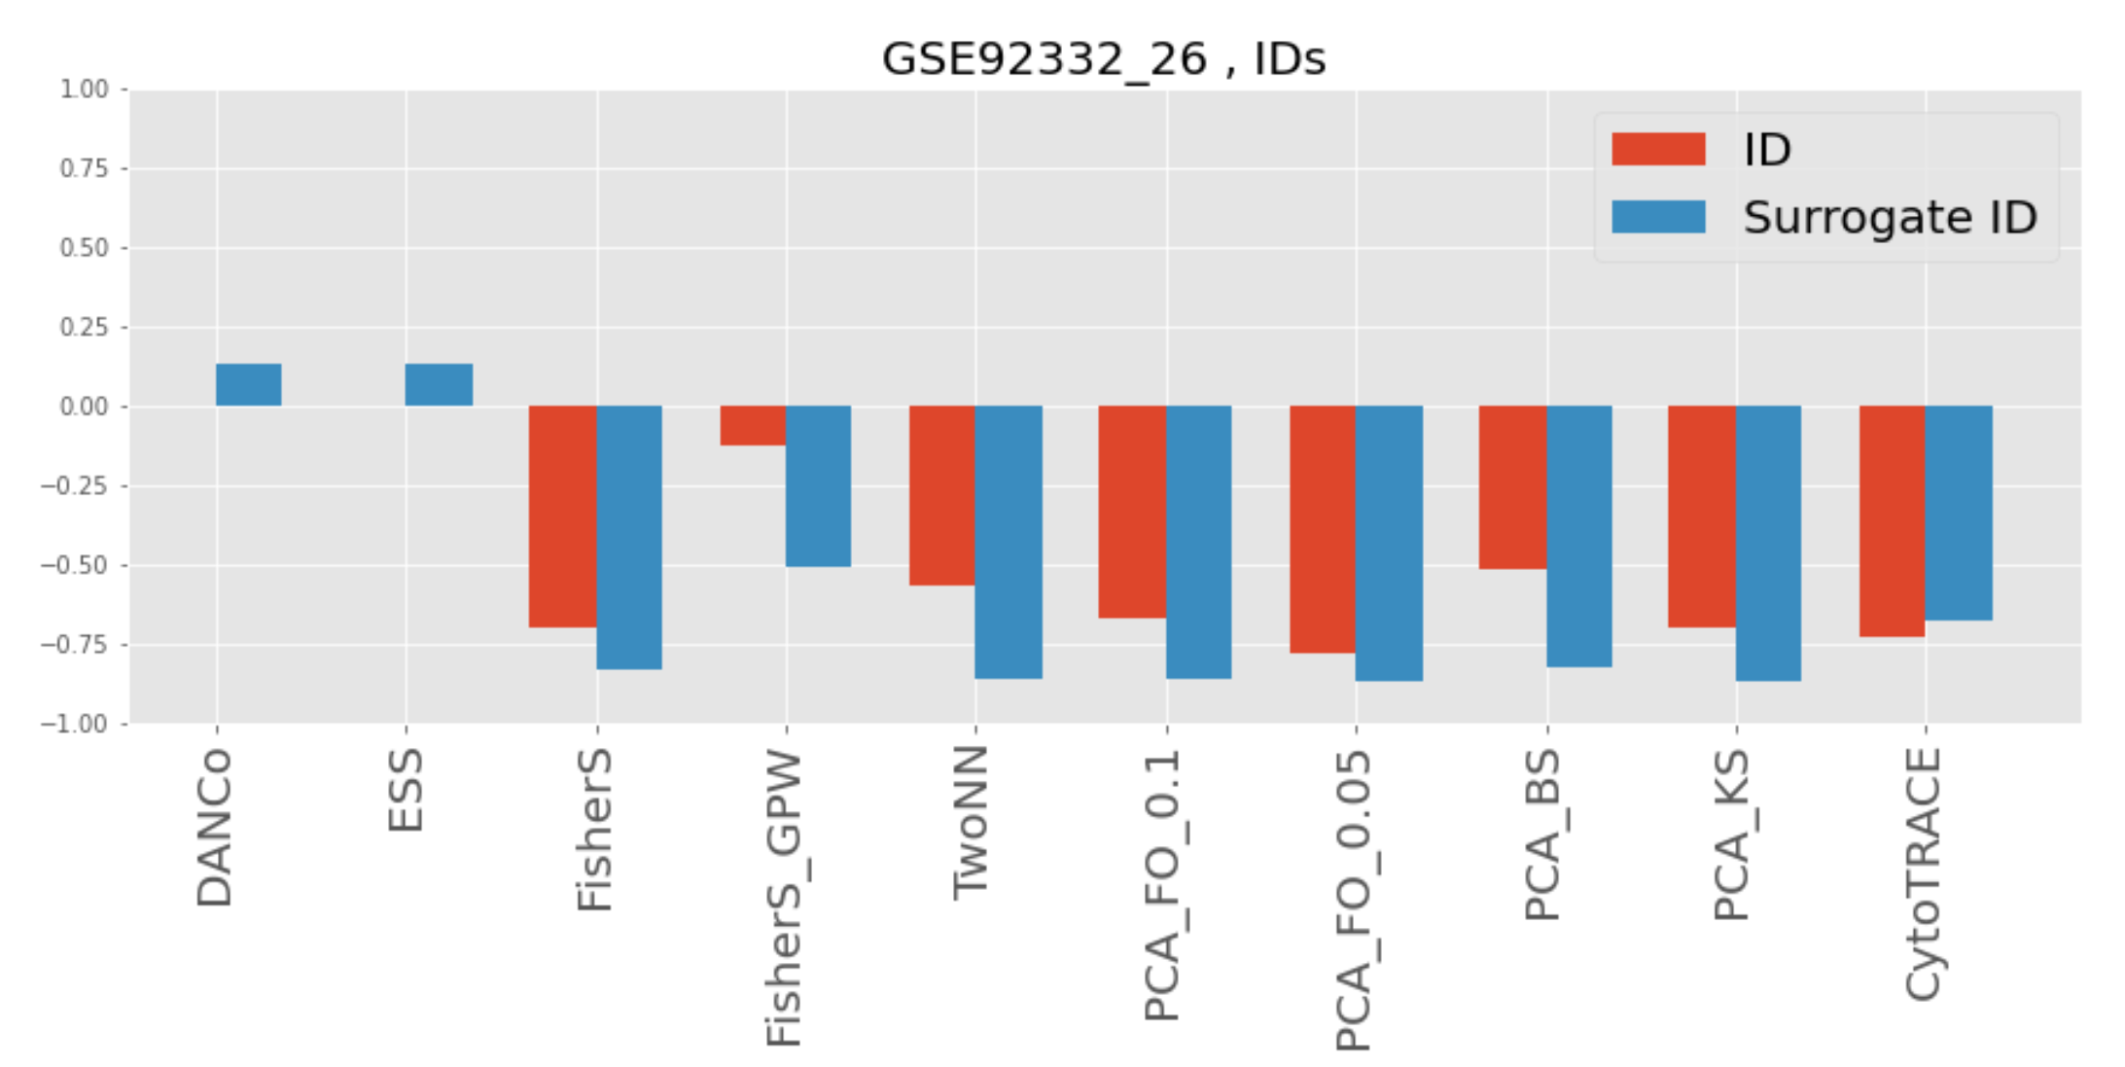
GSE92332_26, overall very good even though Fisher_GPW does not shine

Slide 7
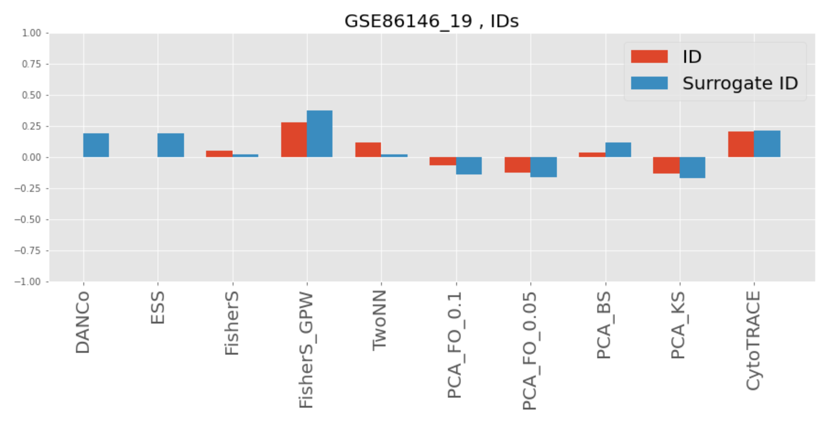
GSE86146_19, Germ cells (Smart-seq2), TPM/FPKM, CytoTRACE and ID failure
One such dataset captures the differentiation of human primordial germ cells (PGCs) into
gametes (‘Germ cells (Smart-seq2)’; table S1). Post-migratory PGCs reset their epigenome via
global demethylation (108, 124). This phenomenon is unique to PGCs and may represent a
scenario that is inconsistent with the features of developmental biology that are captured by
CytoTRACE and other existing methods
Reversed but not bad by absolute value!

Slide 8
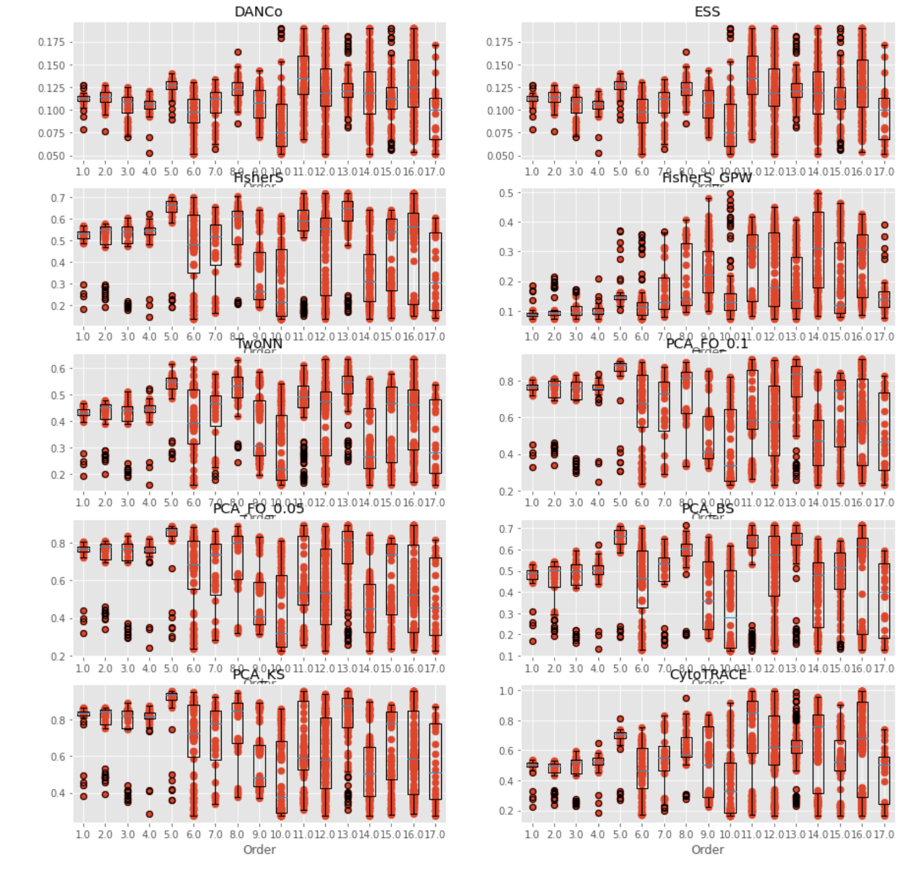
GSE86146_19, Germ cells (Smart-seq2), TPM/FPKM, CytoTRACE and ID failure
Surrogate signatures
One such dataset captures the differentiation of human primordial germ cells (PGCs) into
gametes (‘Germ cells (Smart-seq2)’; table S1). Post-migratory PGCs reset their epigenome via
global demethylation (108, 124). This phenomenon is unique to PGCs and may represent a
scenario that is inconsistent with the features of developmental biology that are captured by
CytoTRACE and other existing methods
Looks like
huge heterogeneity

Slide 9
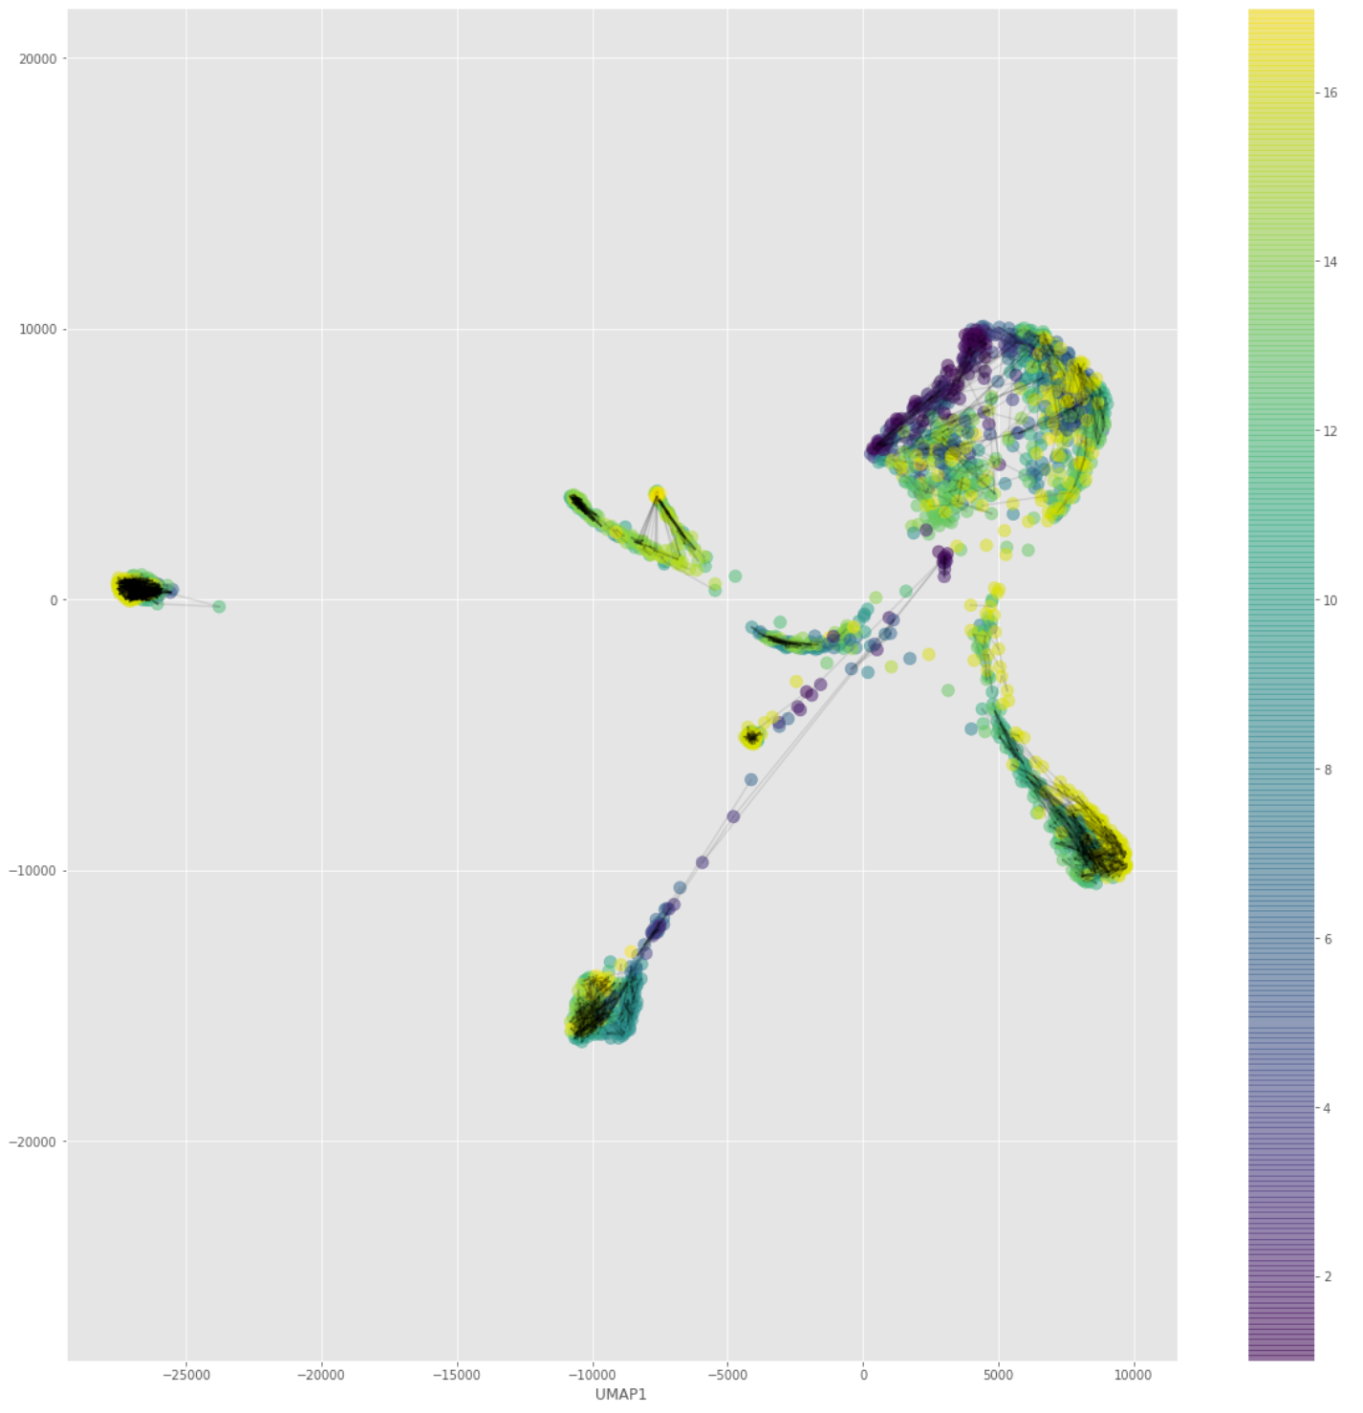
GSE86146_19, Germ cells (Smart-seq2), TPM/FPKM, CytoTRACE and ID failure
One such dataset captures the differentiation of human primordial germ cells (PGCs) into
gametes (‘Germ cells (Smart-seq2)’; table S1). Post-migratory PGCs reset their epigenome via
global demethylation (108, 124). This phenomenon is unique to PGCs and may represent a
scenario that is inconsistent with the features of developmental biology that are captured by
CytoTRACE and other existing methods
Here is the source
of bimodality

Slide 10
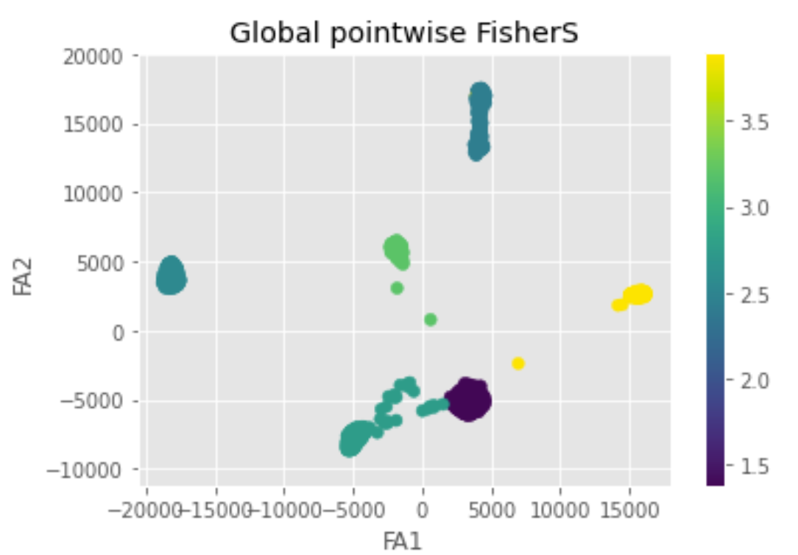
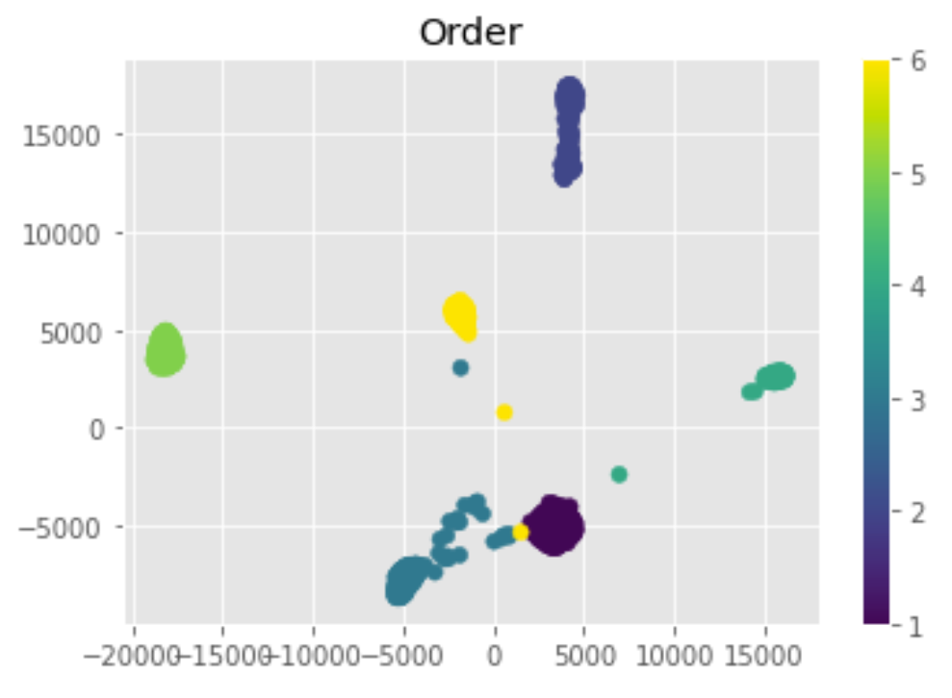
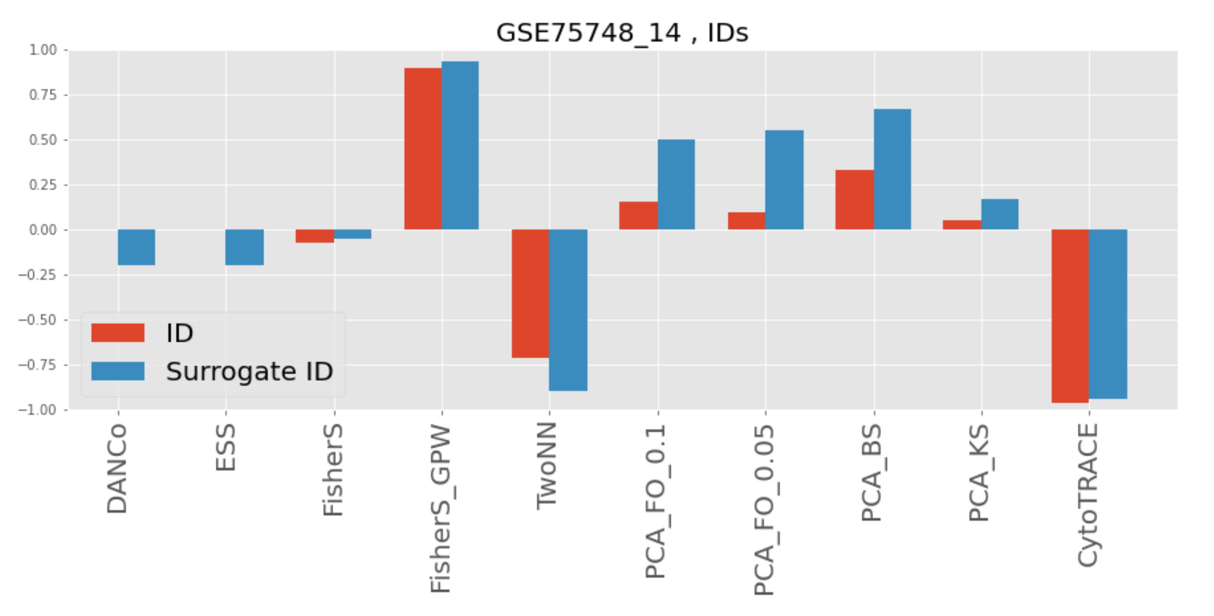
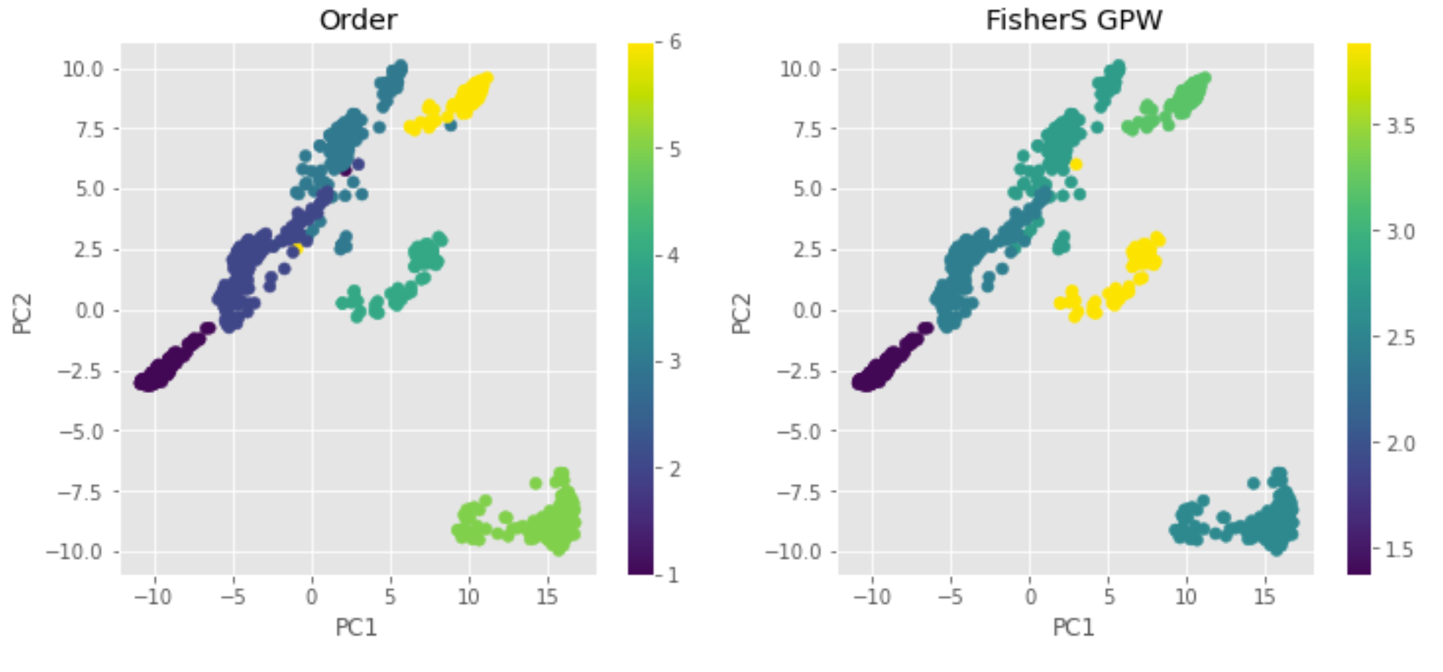
GSE75748_14, hESC in vitro (C1), TPM/FPKM,
Suspicious?

Slide 11
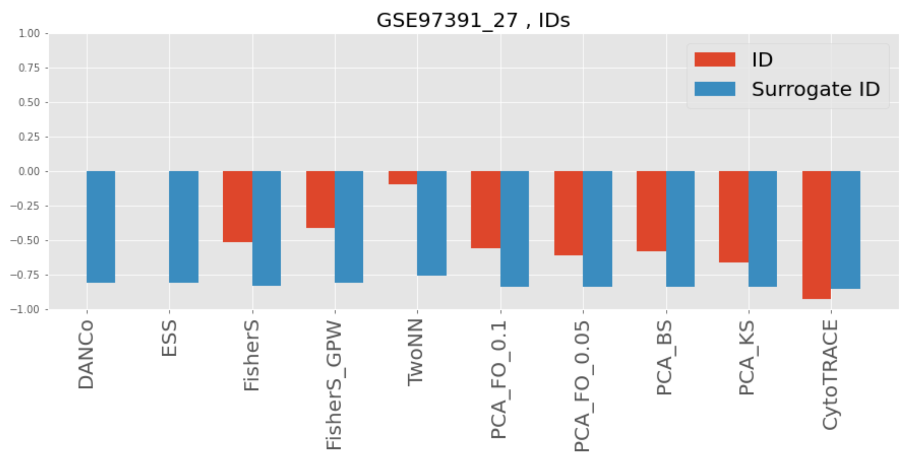
GSE97391_27, Standard in vitro neuron (inDrop), UMI, all good

Slide 12
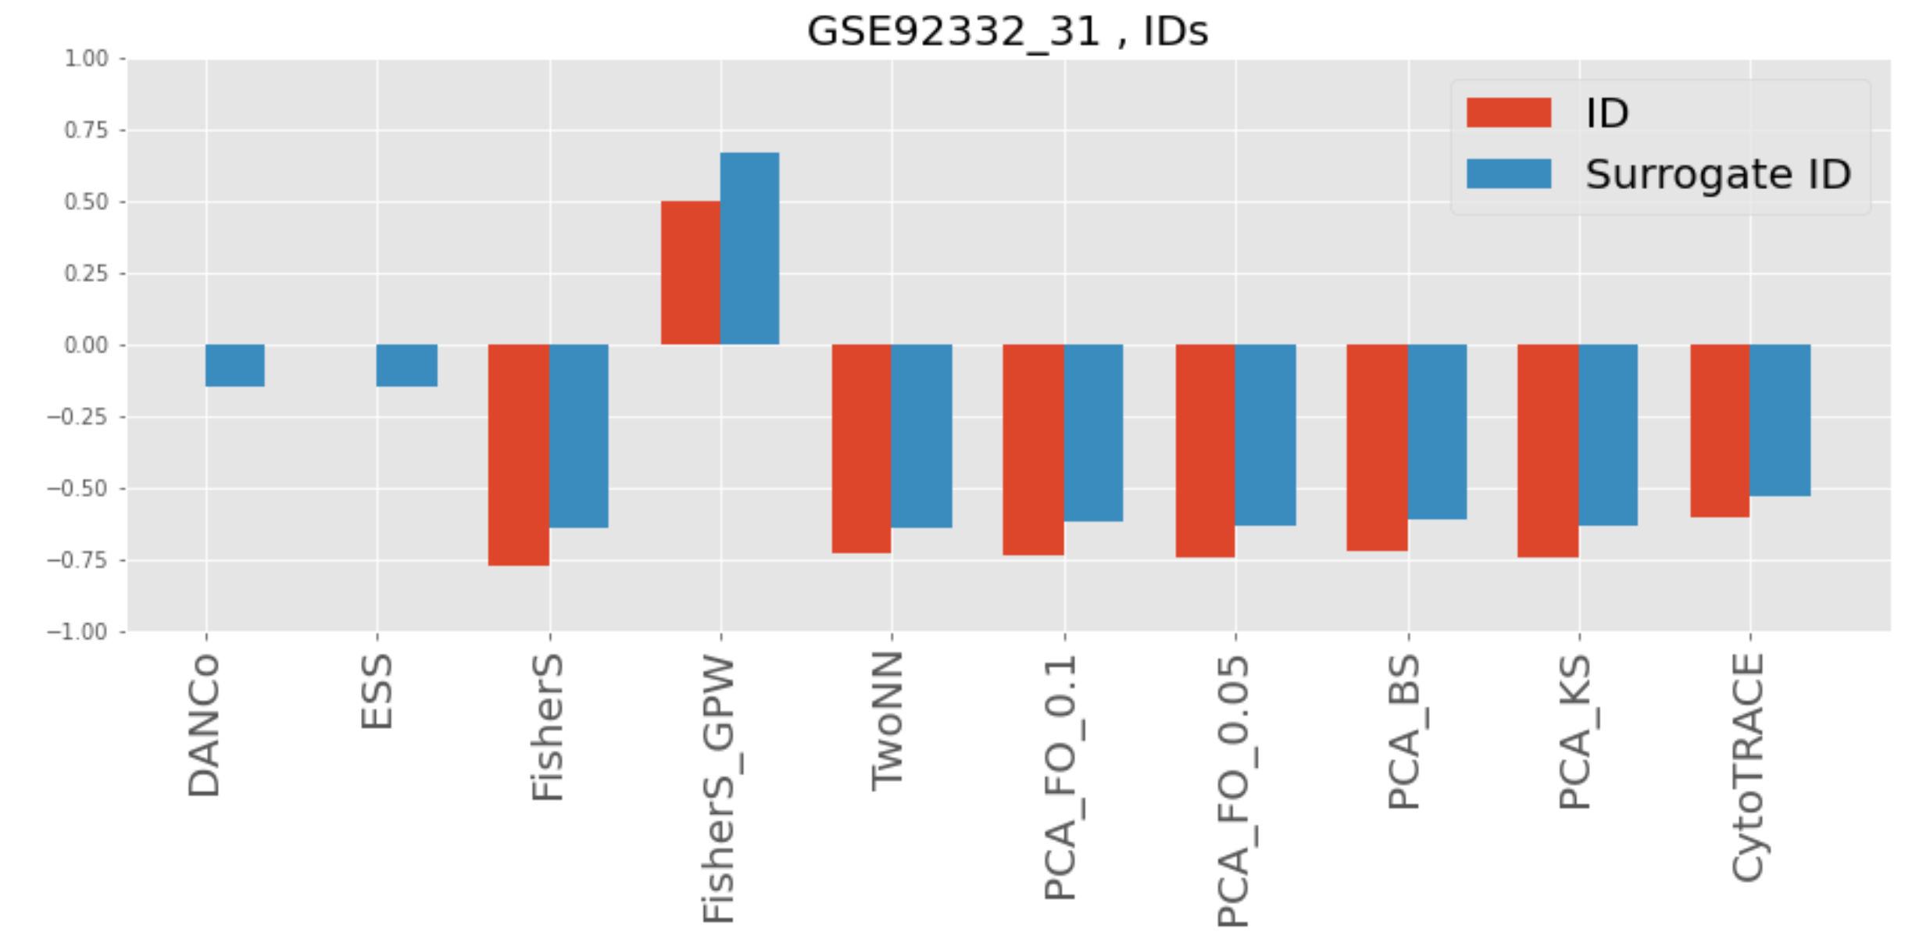
GSE92332_31, Intestine (Drop-seq), UMI
Strange! Surrogate signatures behave worse than their IDs (besides FisherS GPW) – check normalization

Slide 13
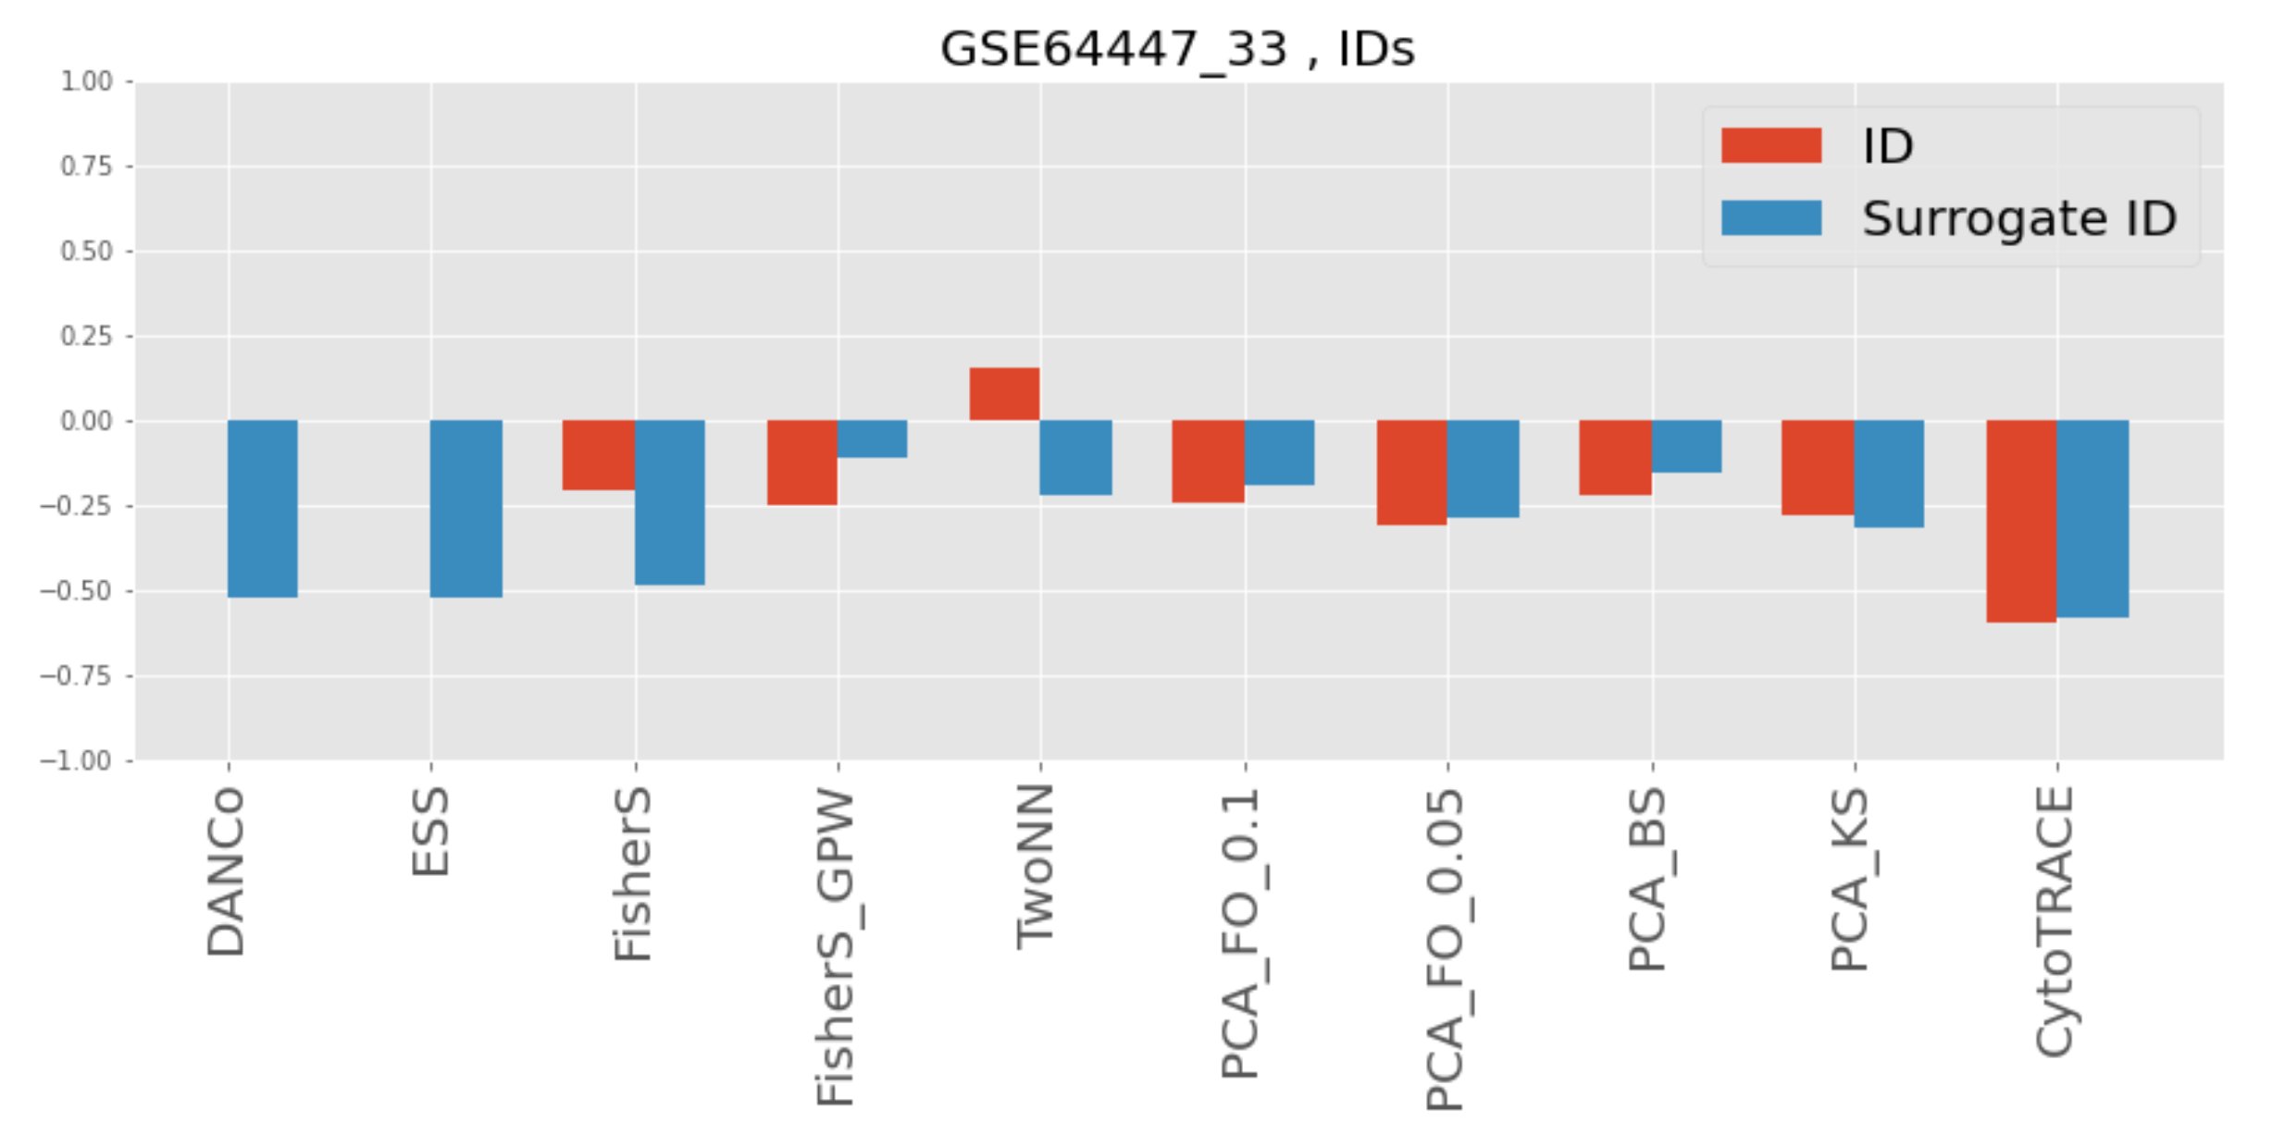
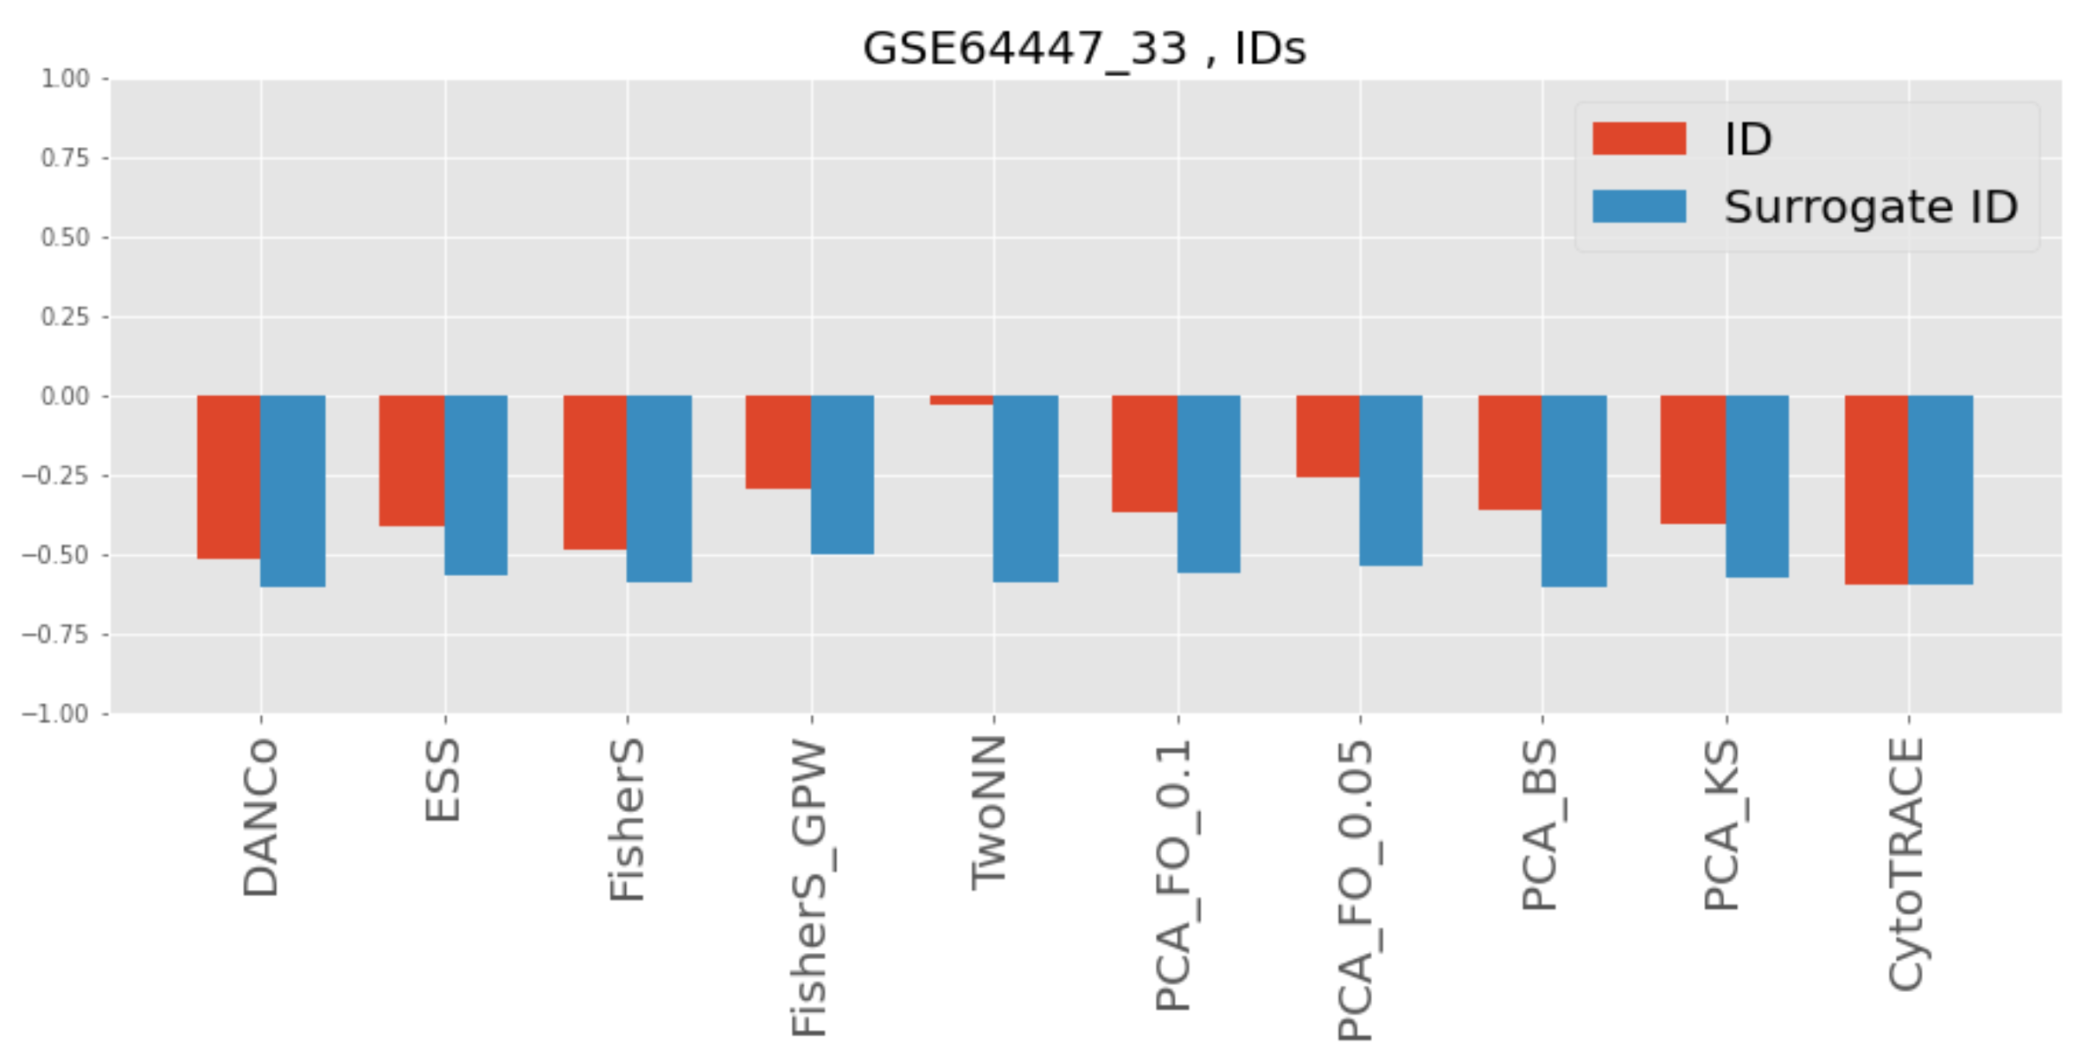
GSE64447_33, Skeletal stem cells (C1), TPM/FPKM
Depends a lot on parameters
With pooling, cond_number=10, n_comp = 20
Without pooling, cond_number=25, n_comp = 20

Slide 14
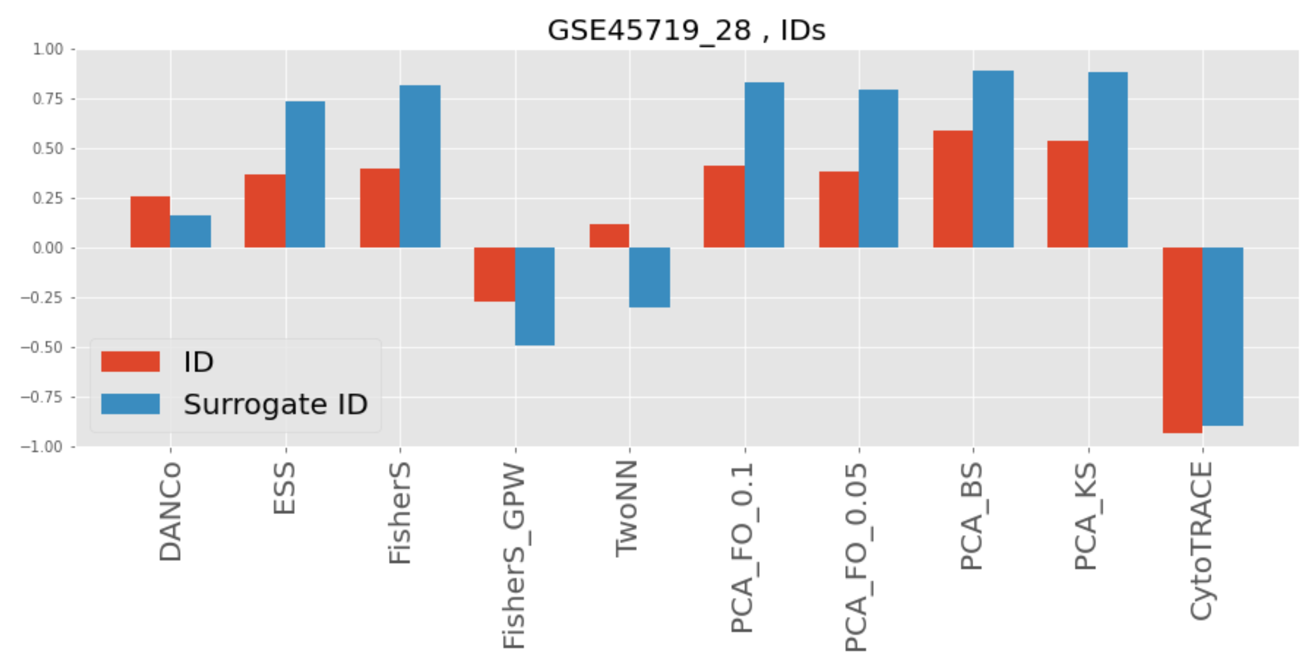
GSE45719_28, Pre-implant mouse embryo (Tang et al.), TPM/FPKM
Without pooling, cond_number=8, n_comp = 20, n_neigh=10%

Slide 15
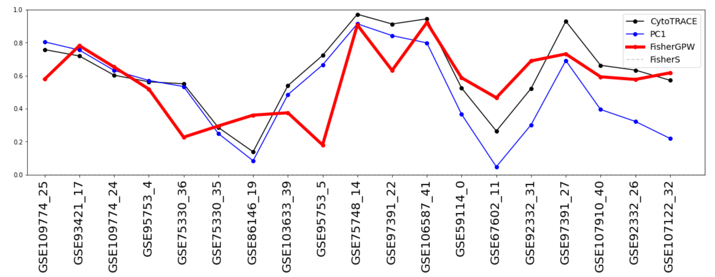
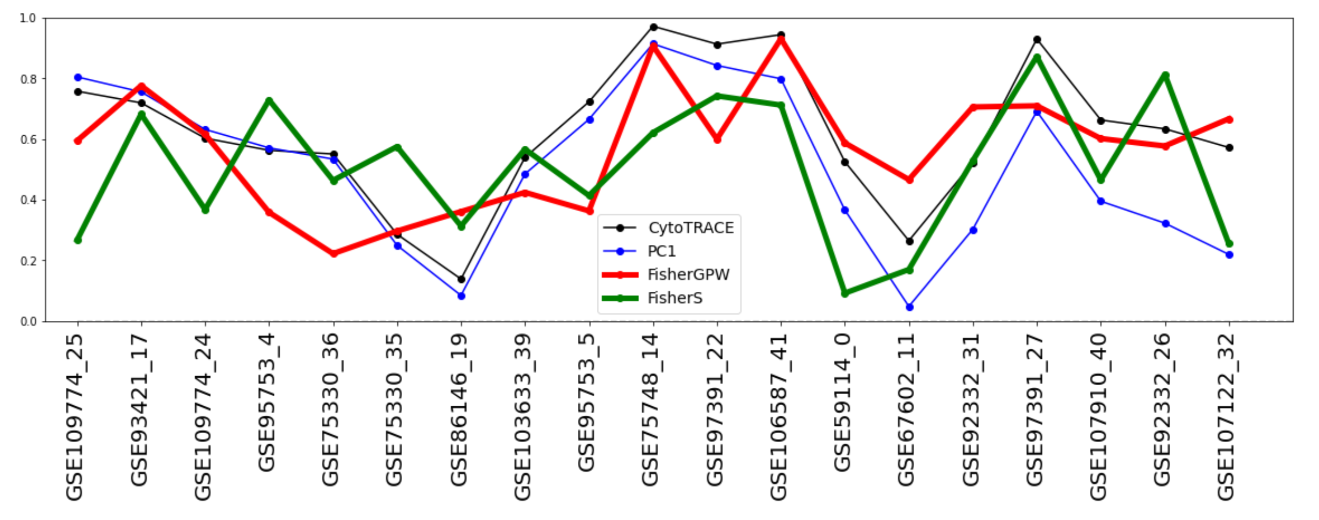
N_pool = 10
n_neighbours_for_pooling = max(10,int(len(adata)/200))

Slide 16
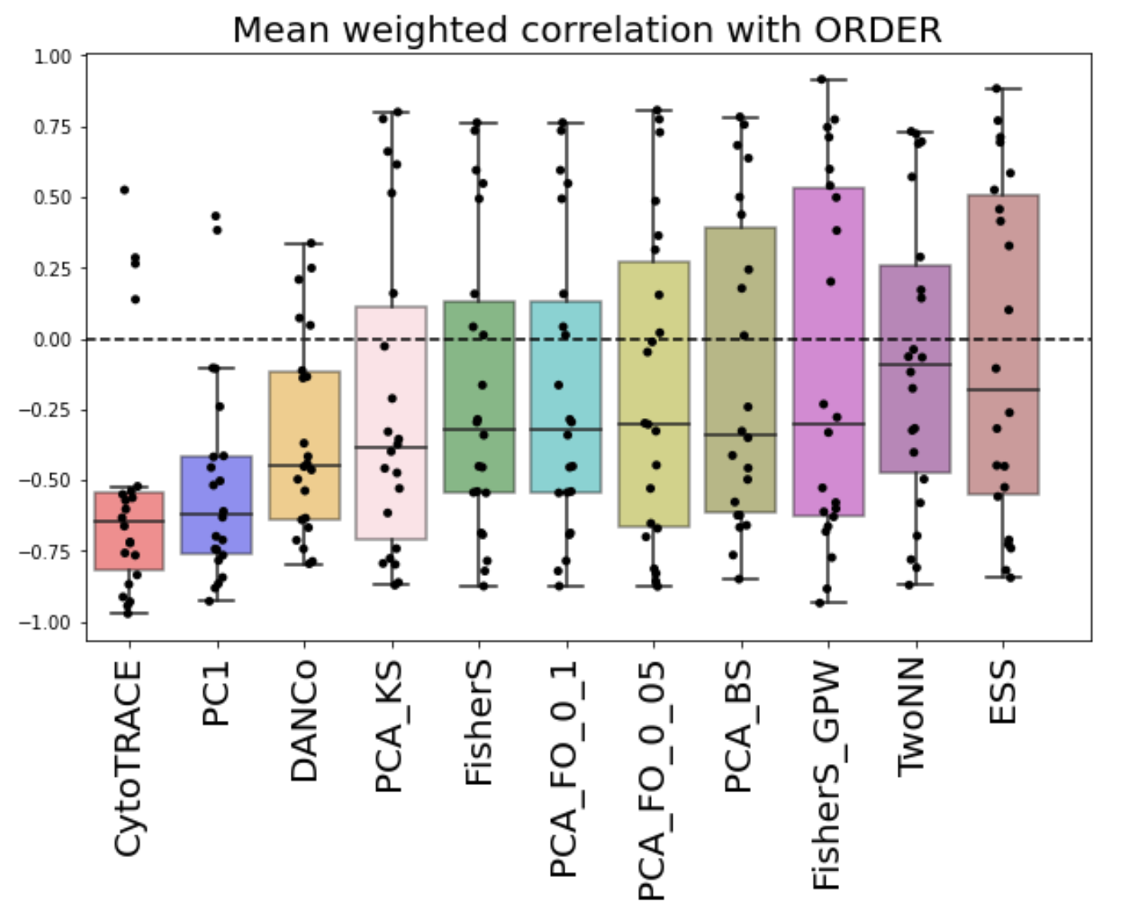
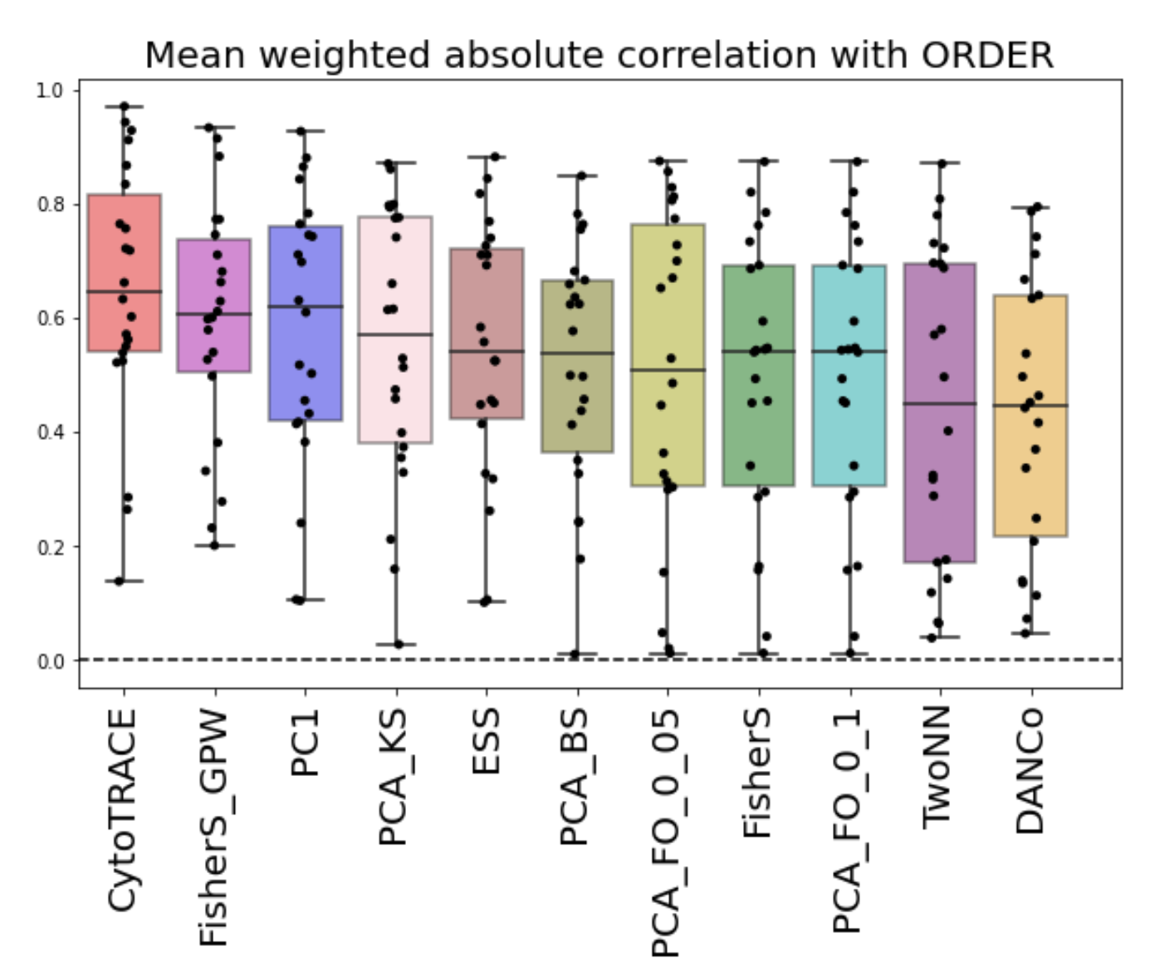

Slide 17
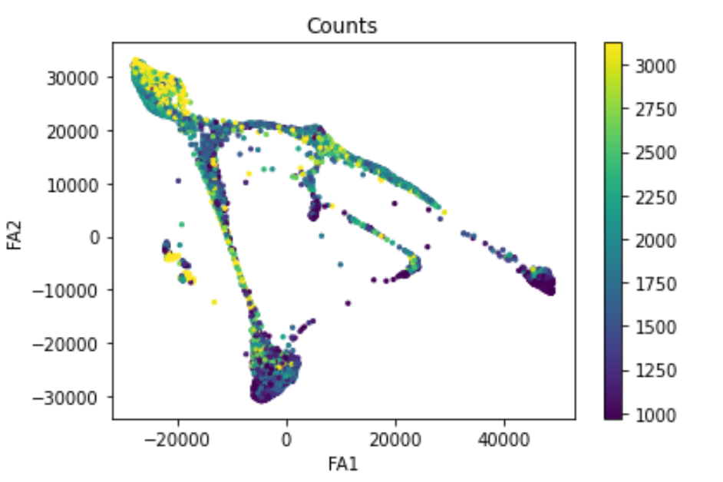
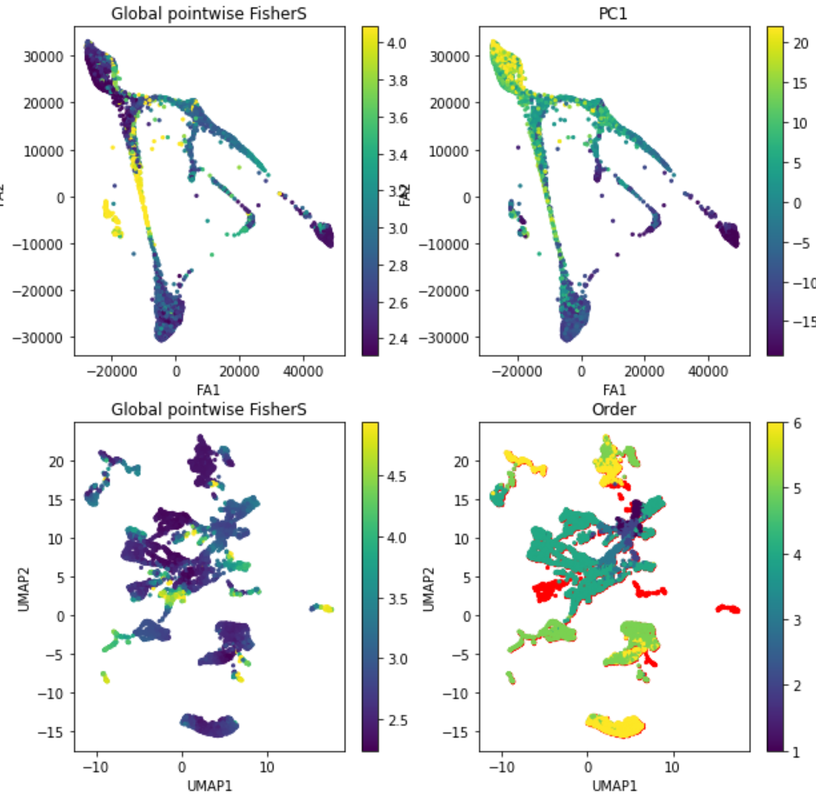
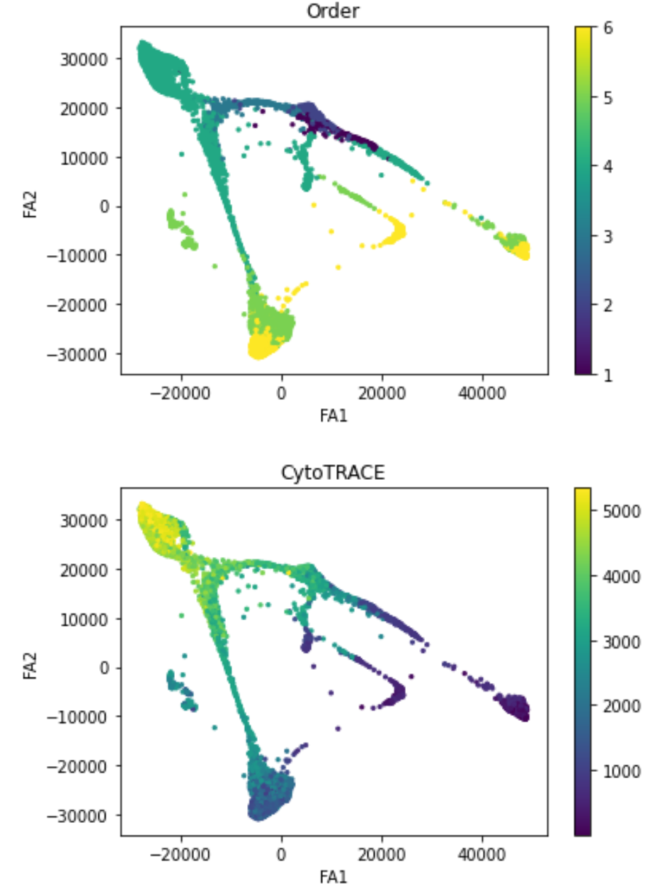
Dataset 4

Slide 18
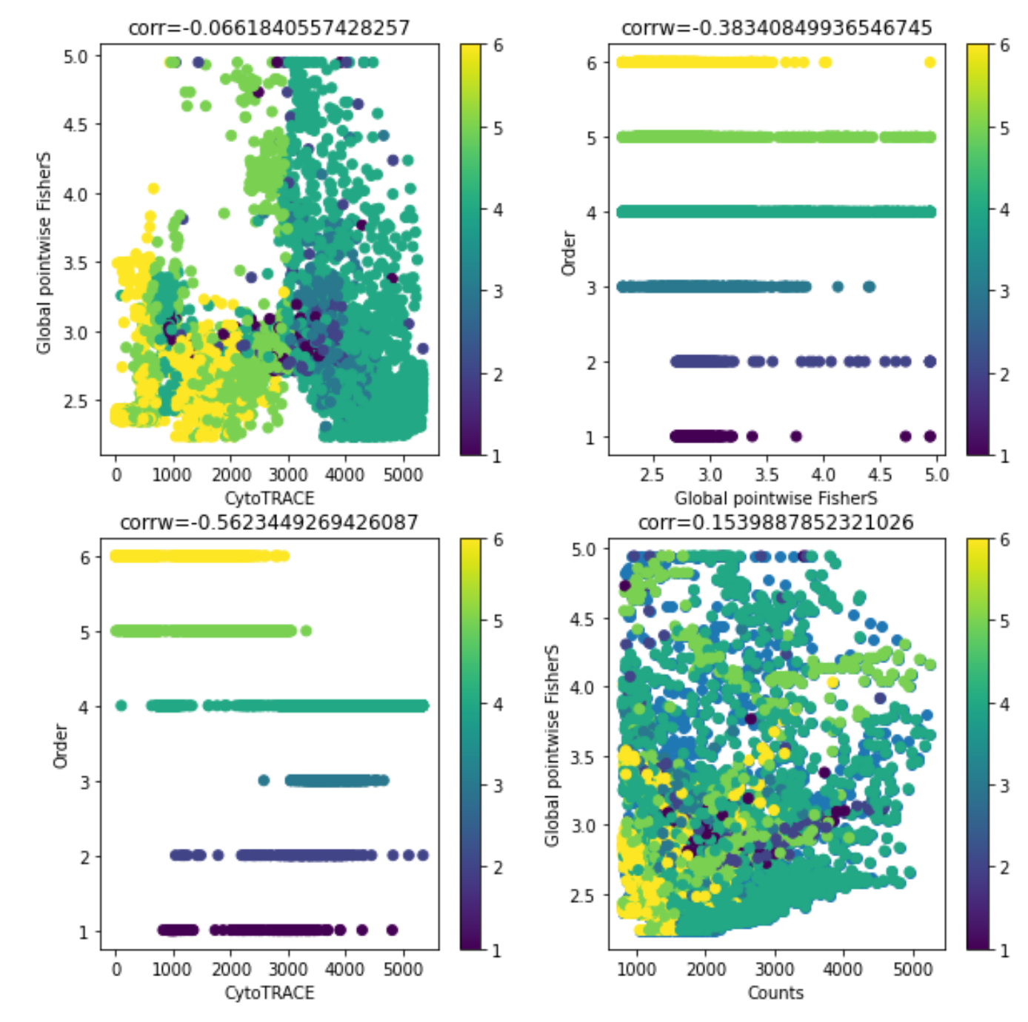
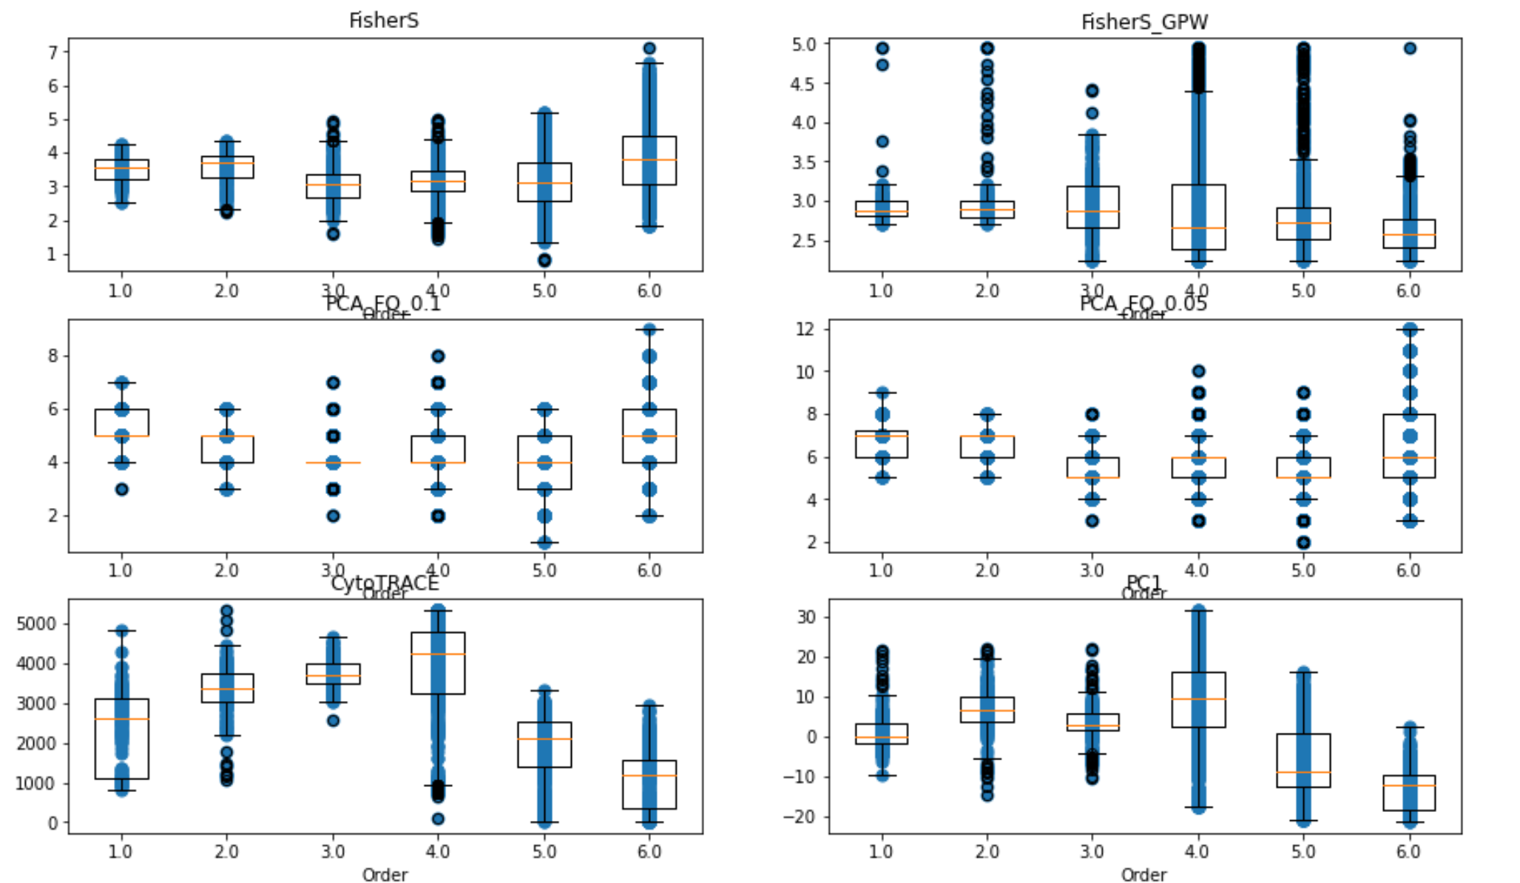

Slide 19
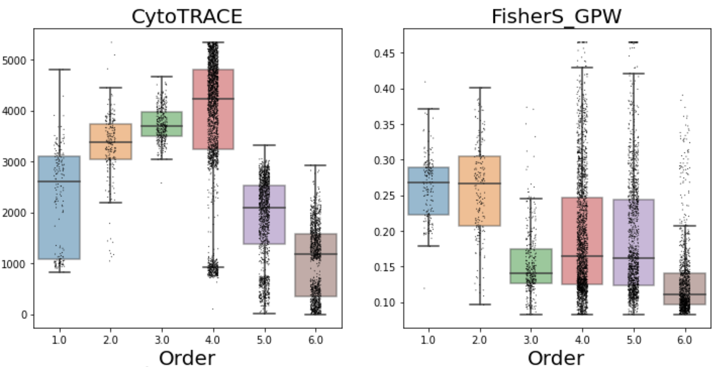
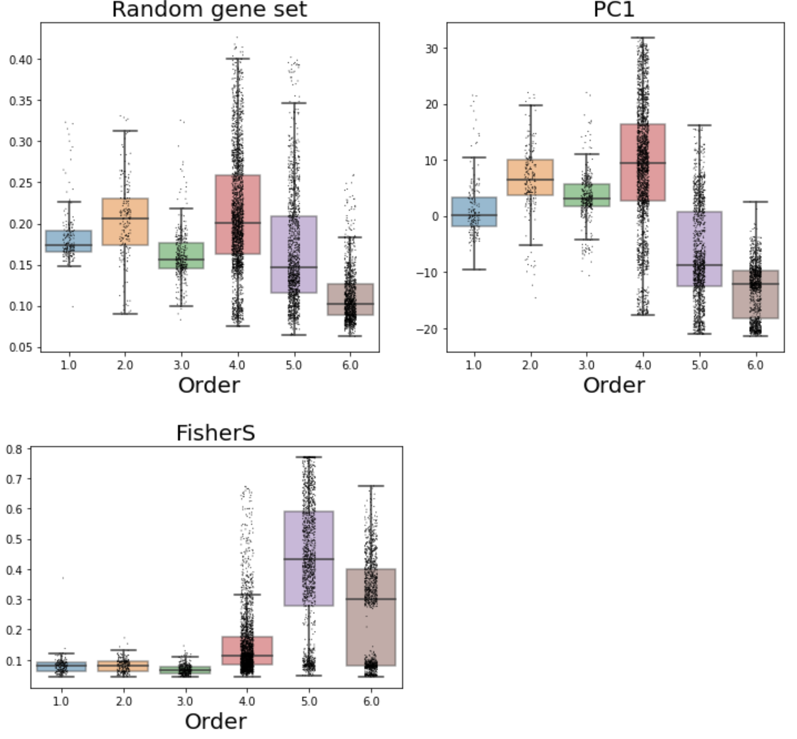

Slide 20
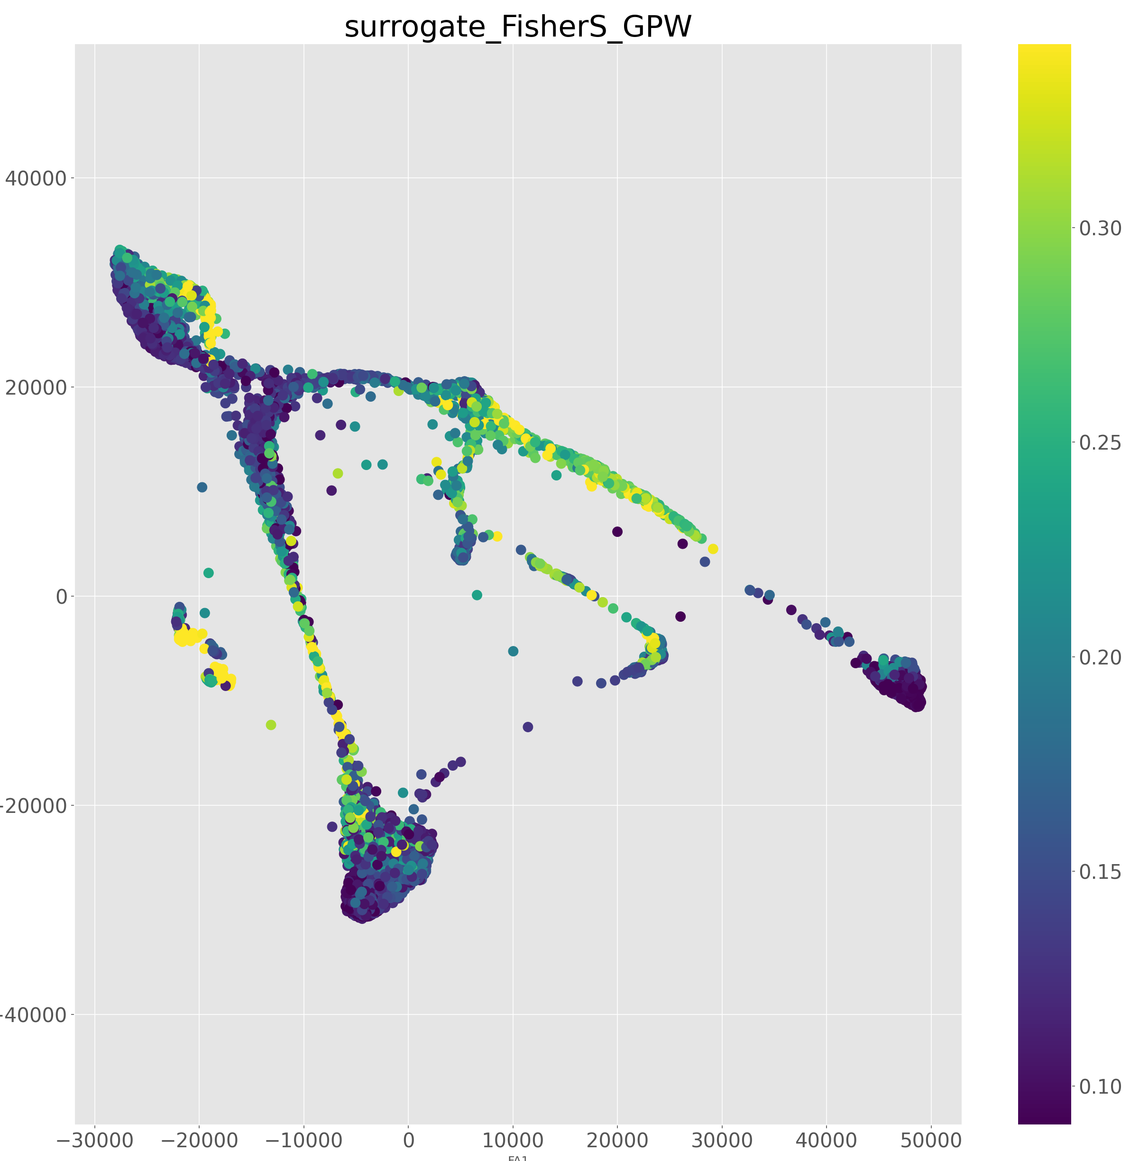
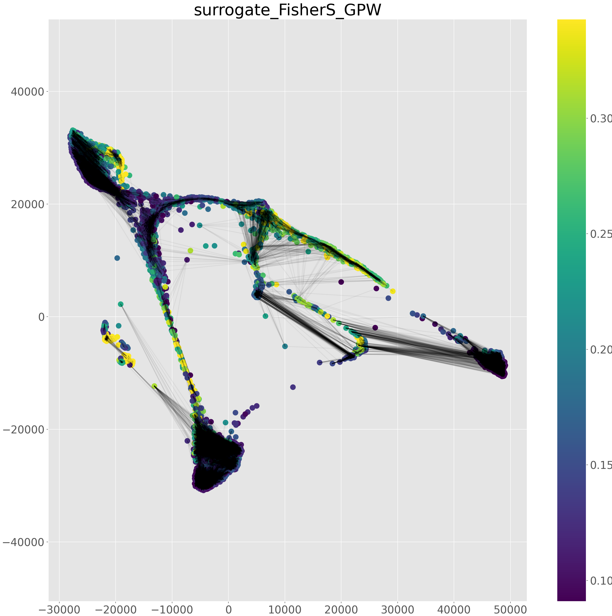
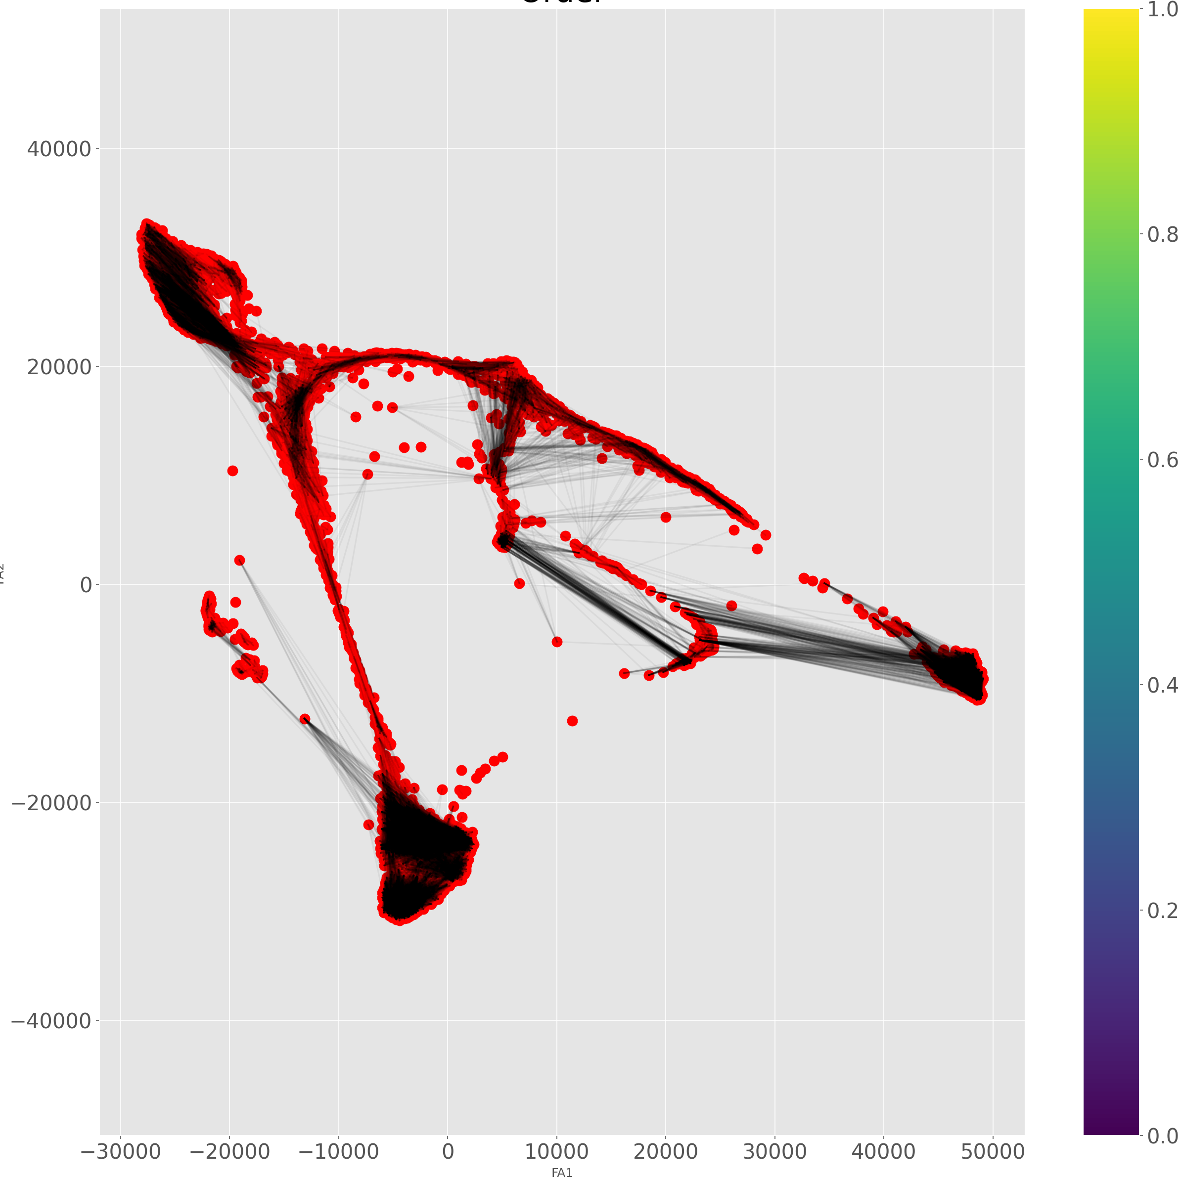
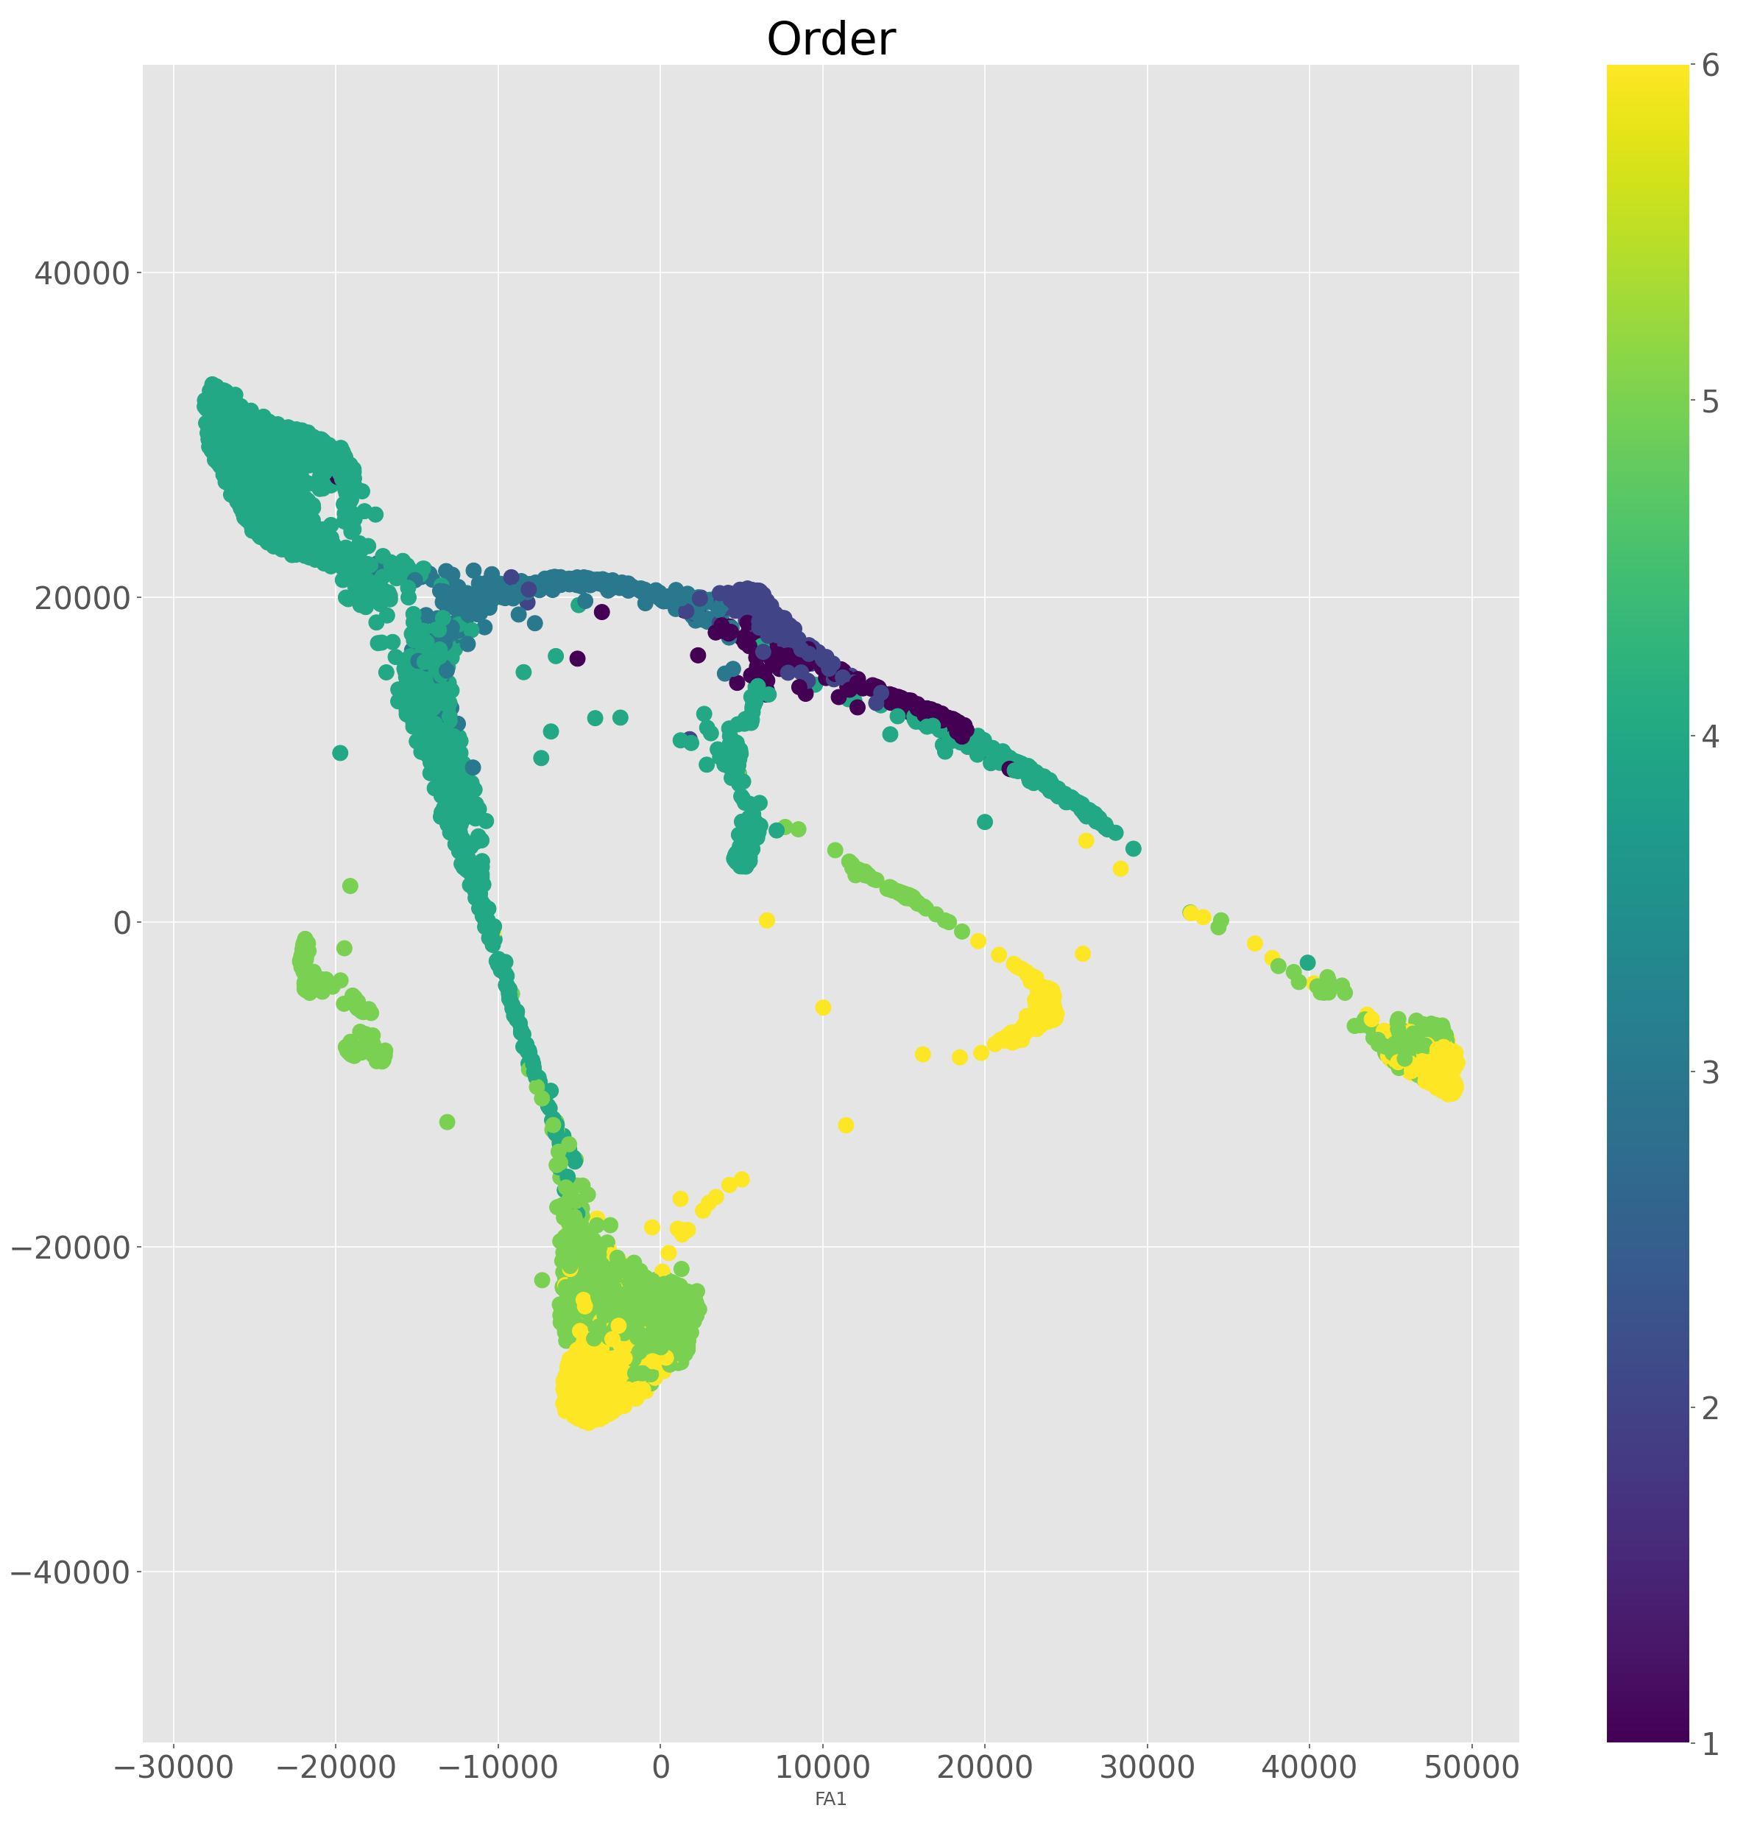
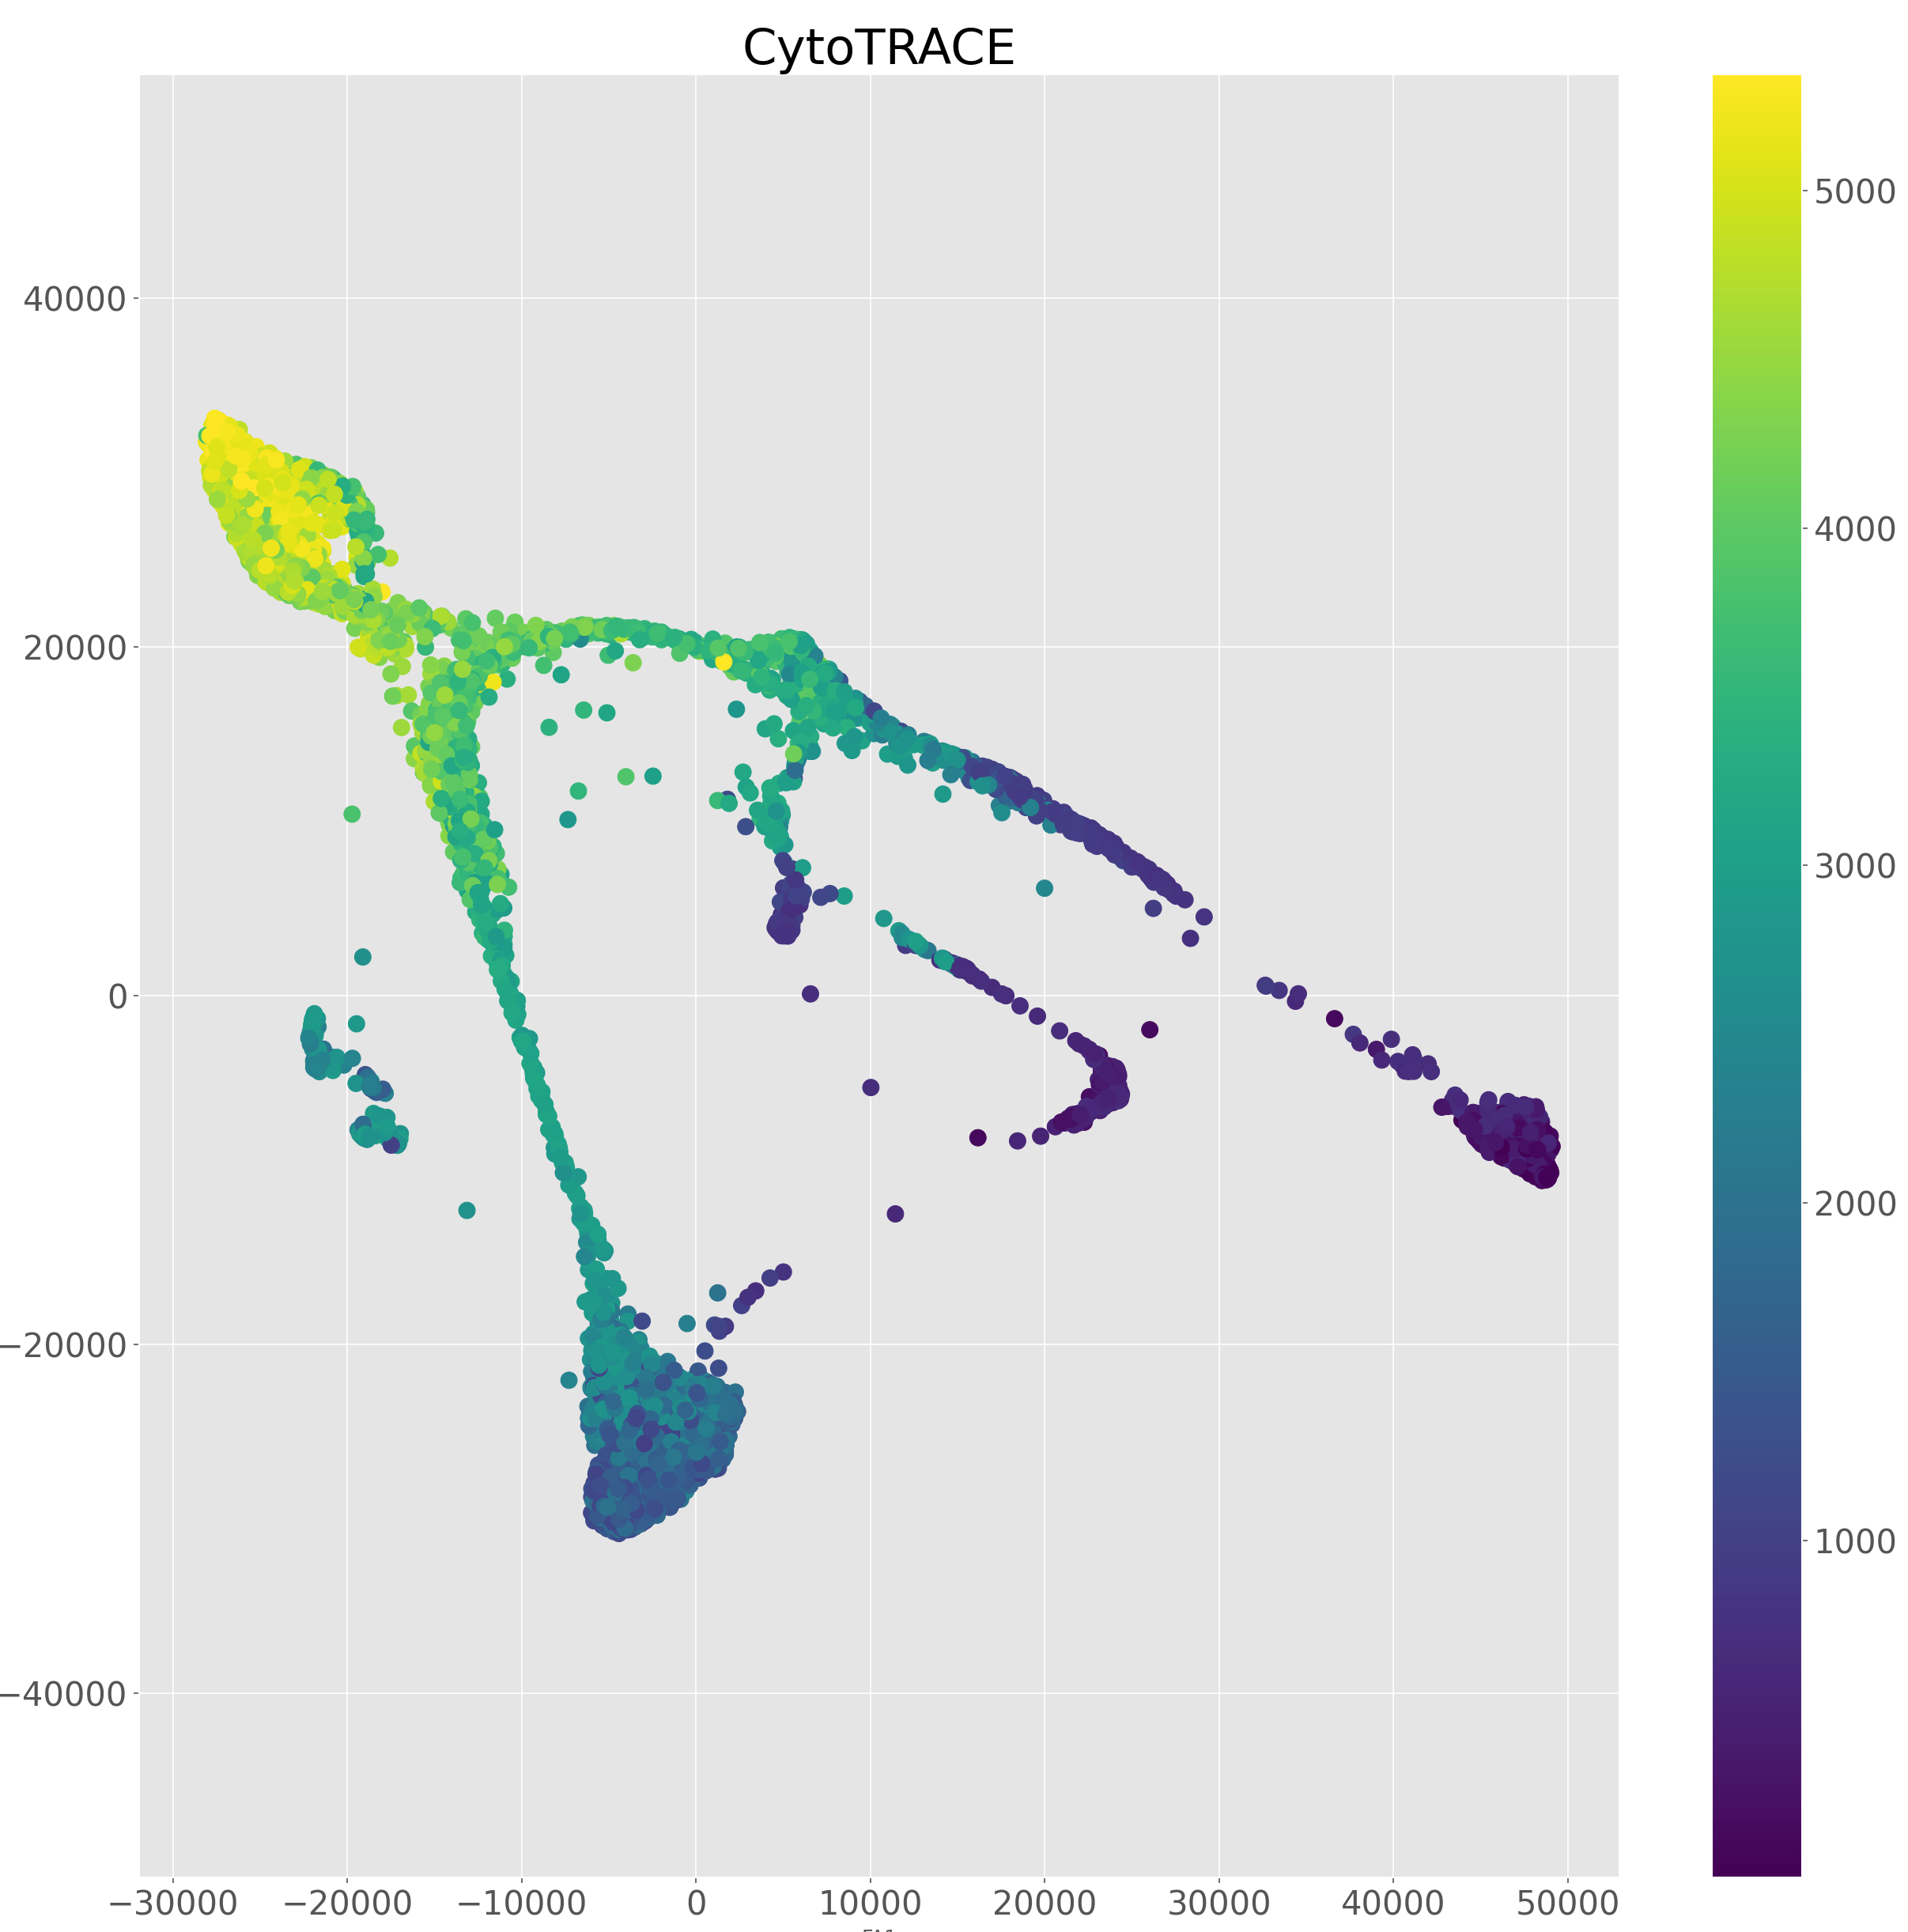

Slide 21
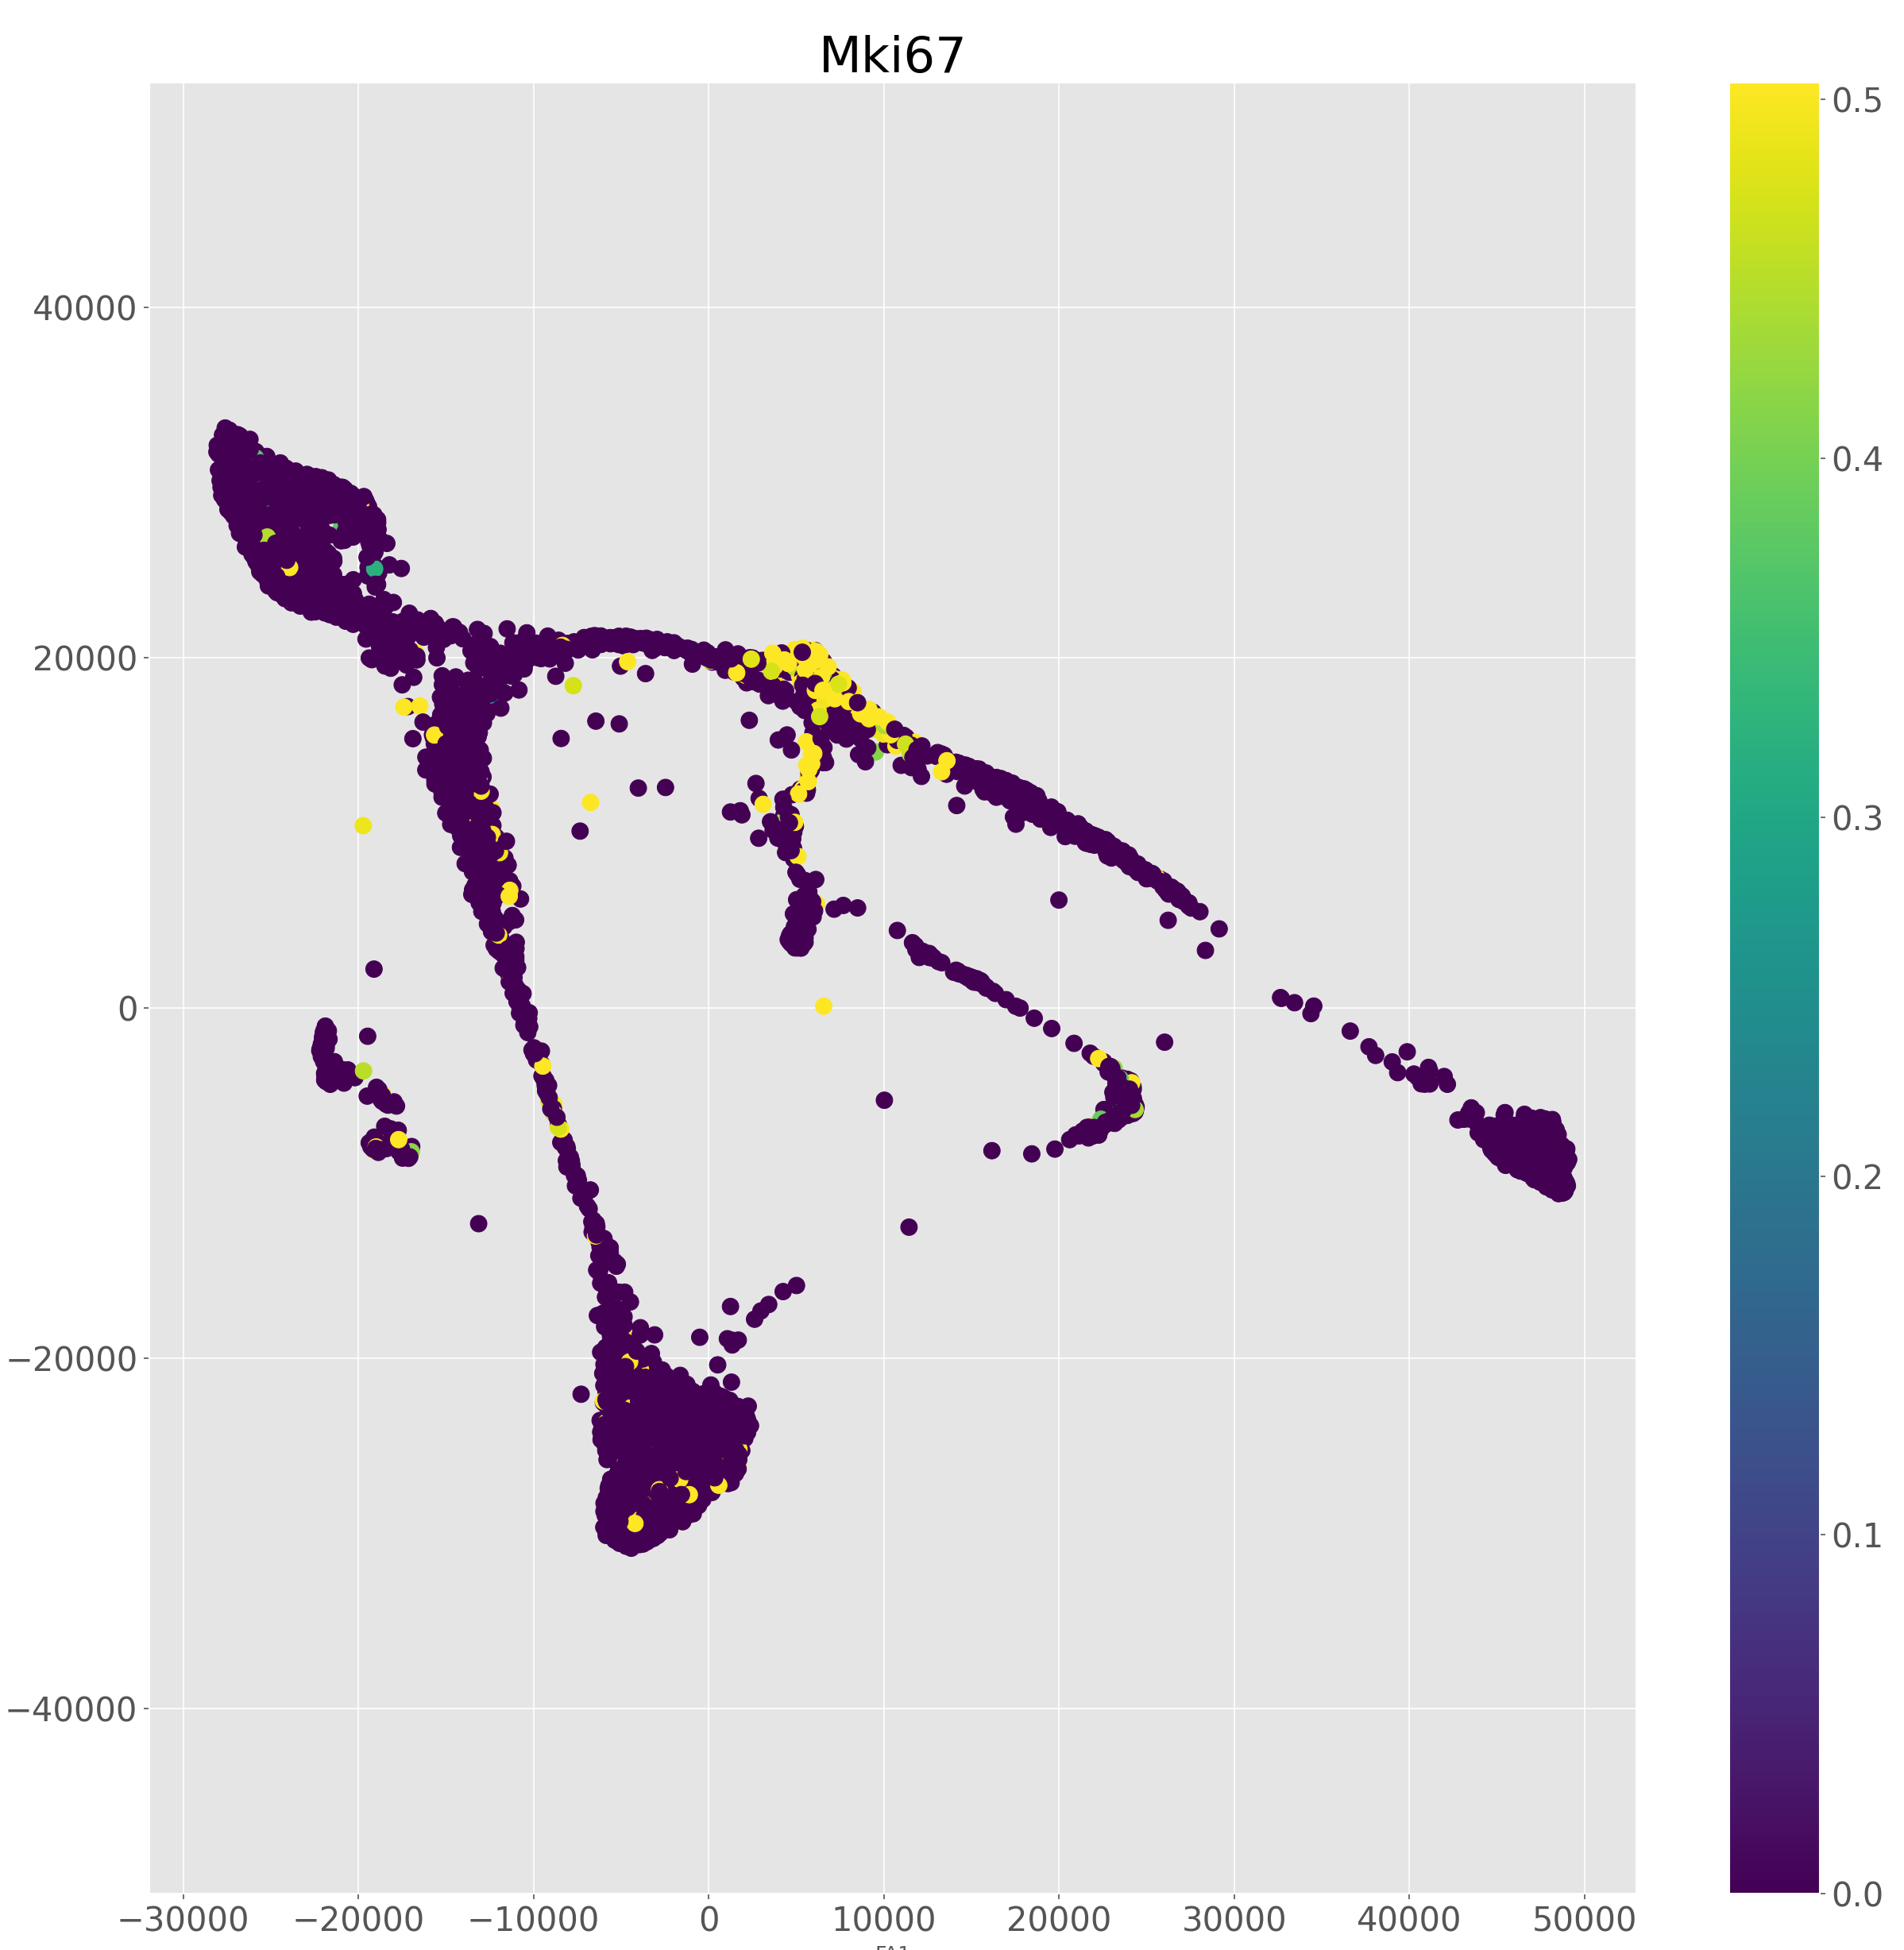
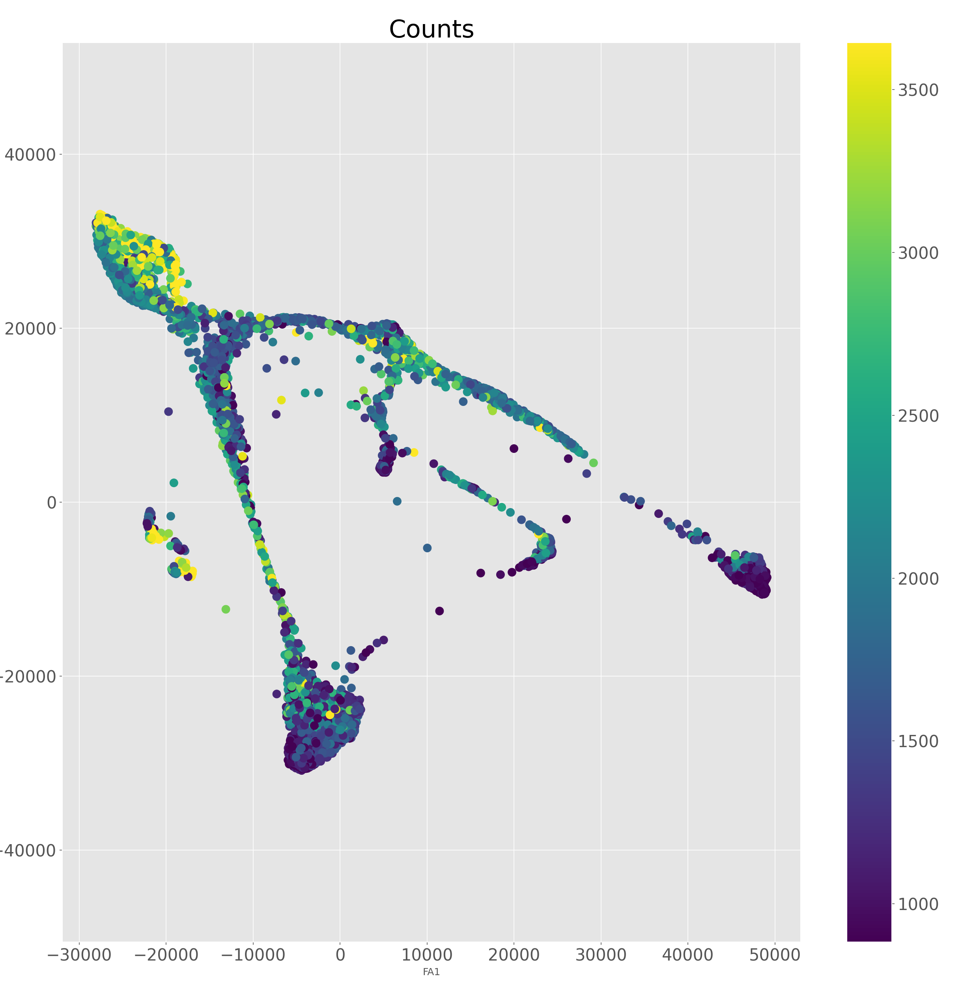

Slide 22
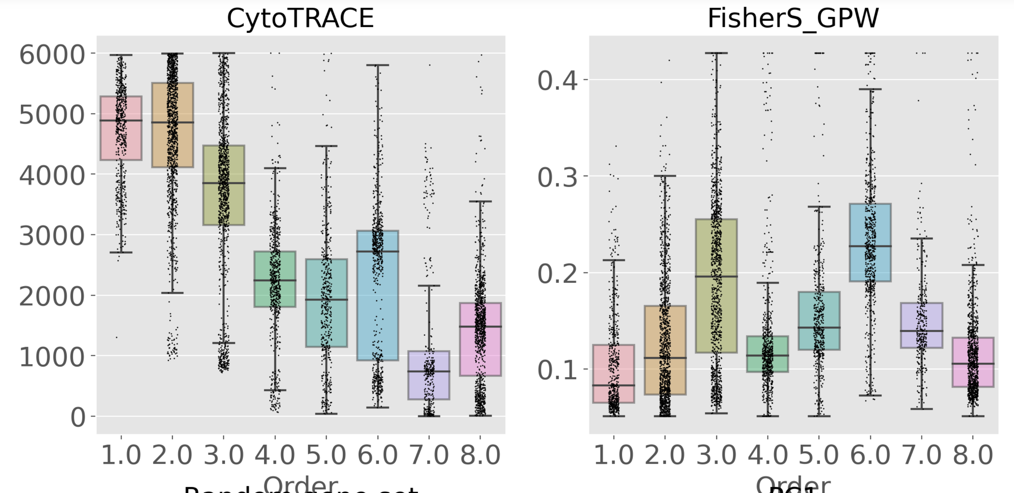
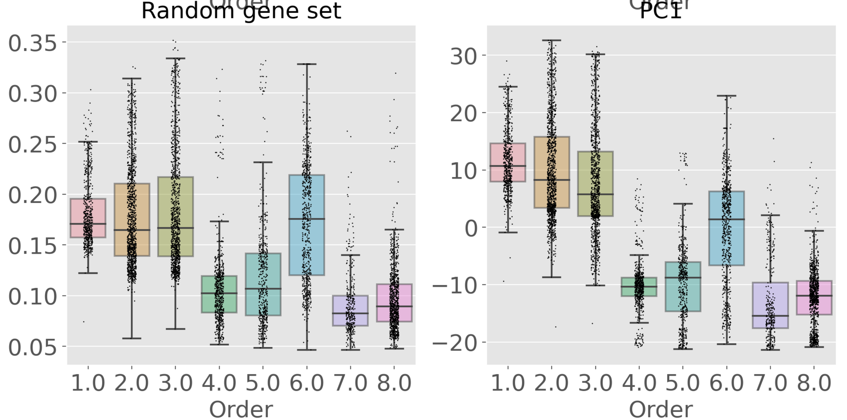

Slide 23
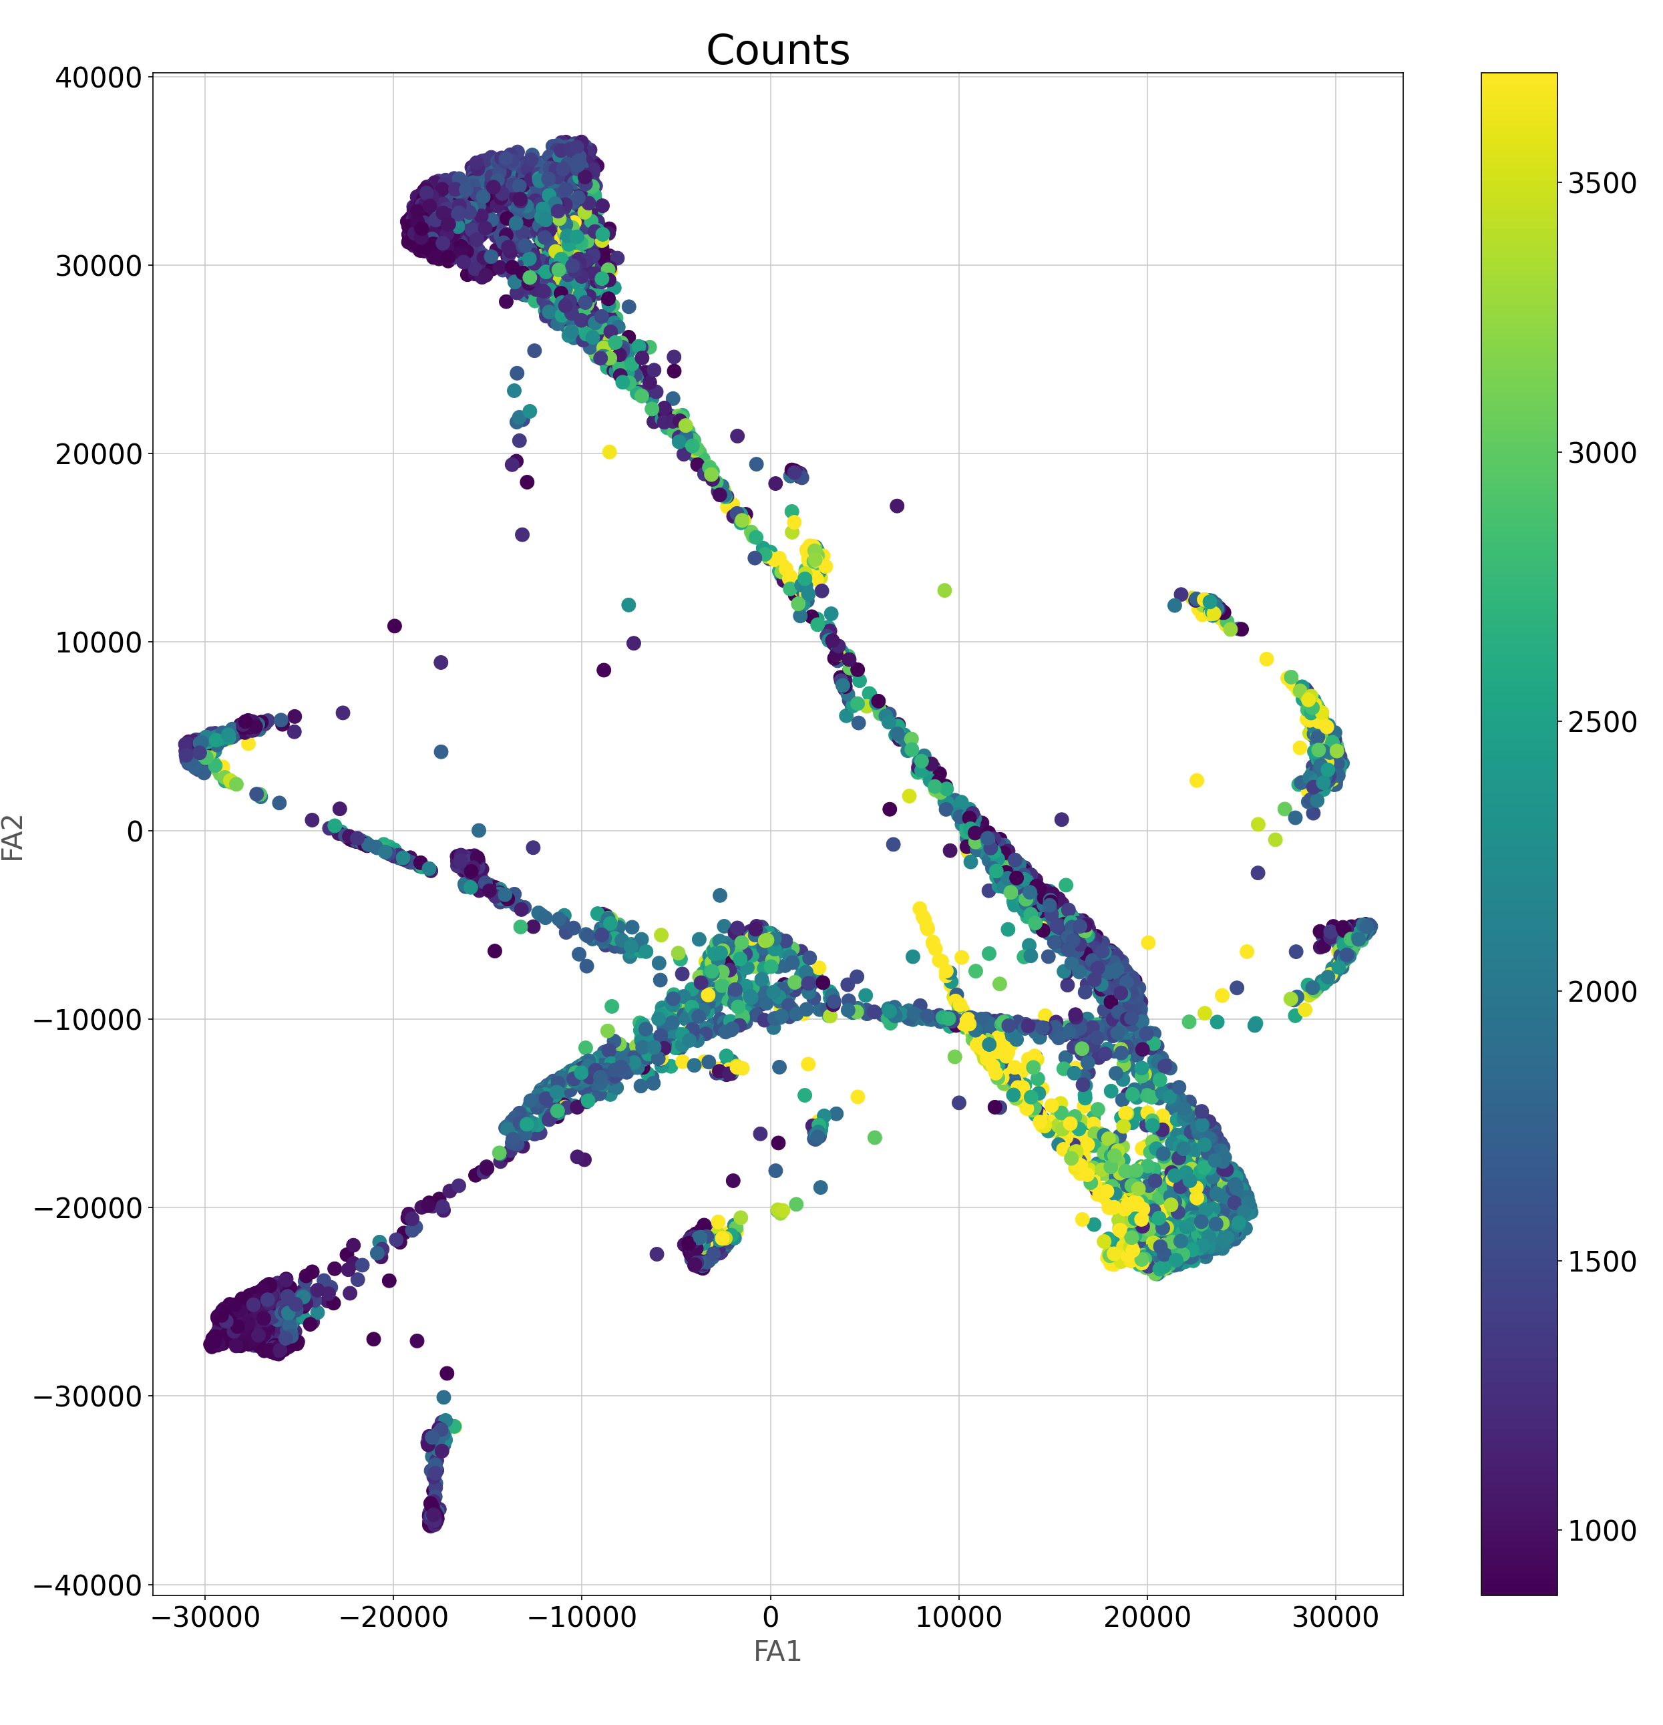
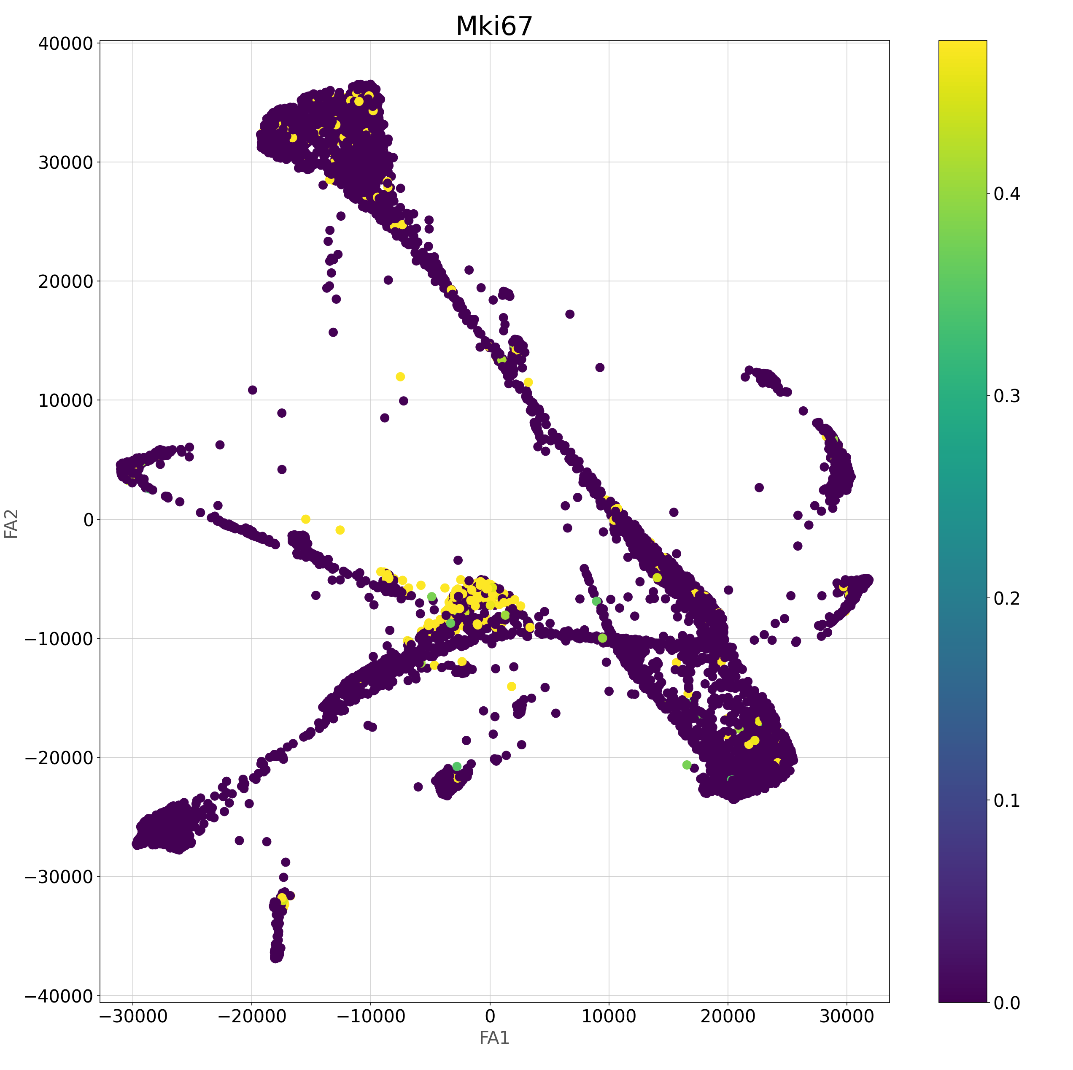

Slide 24
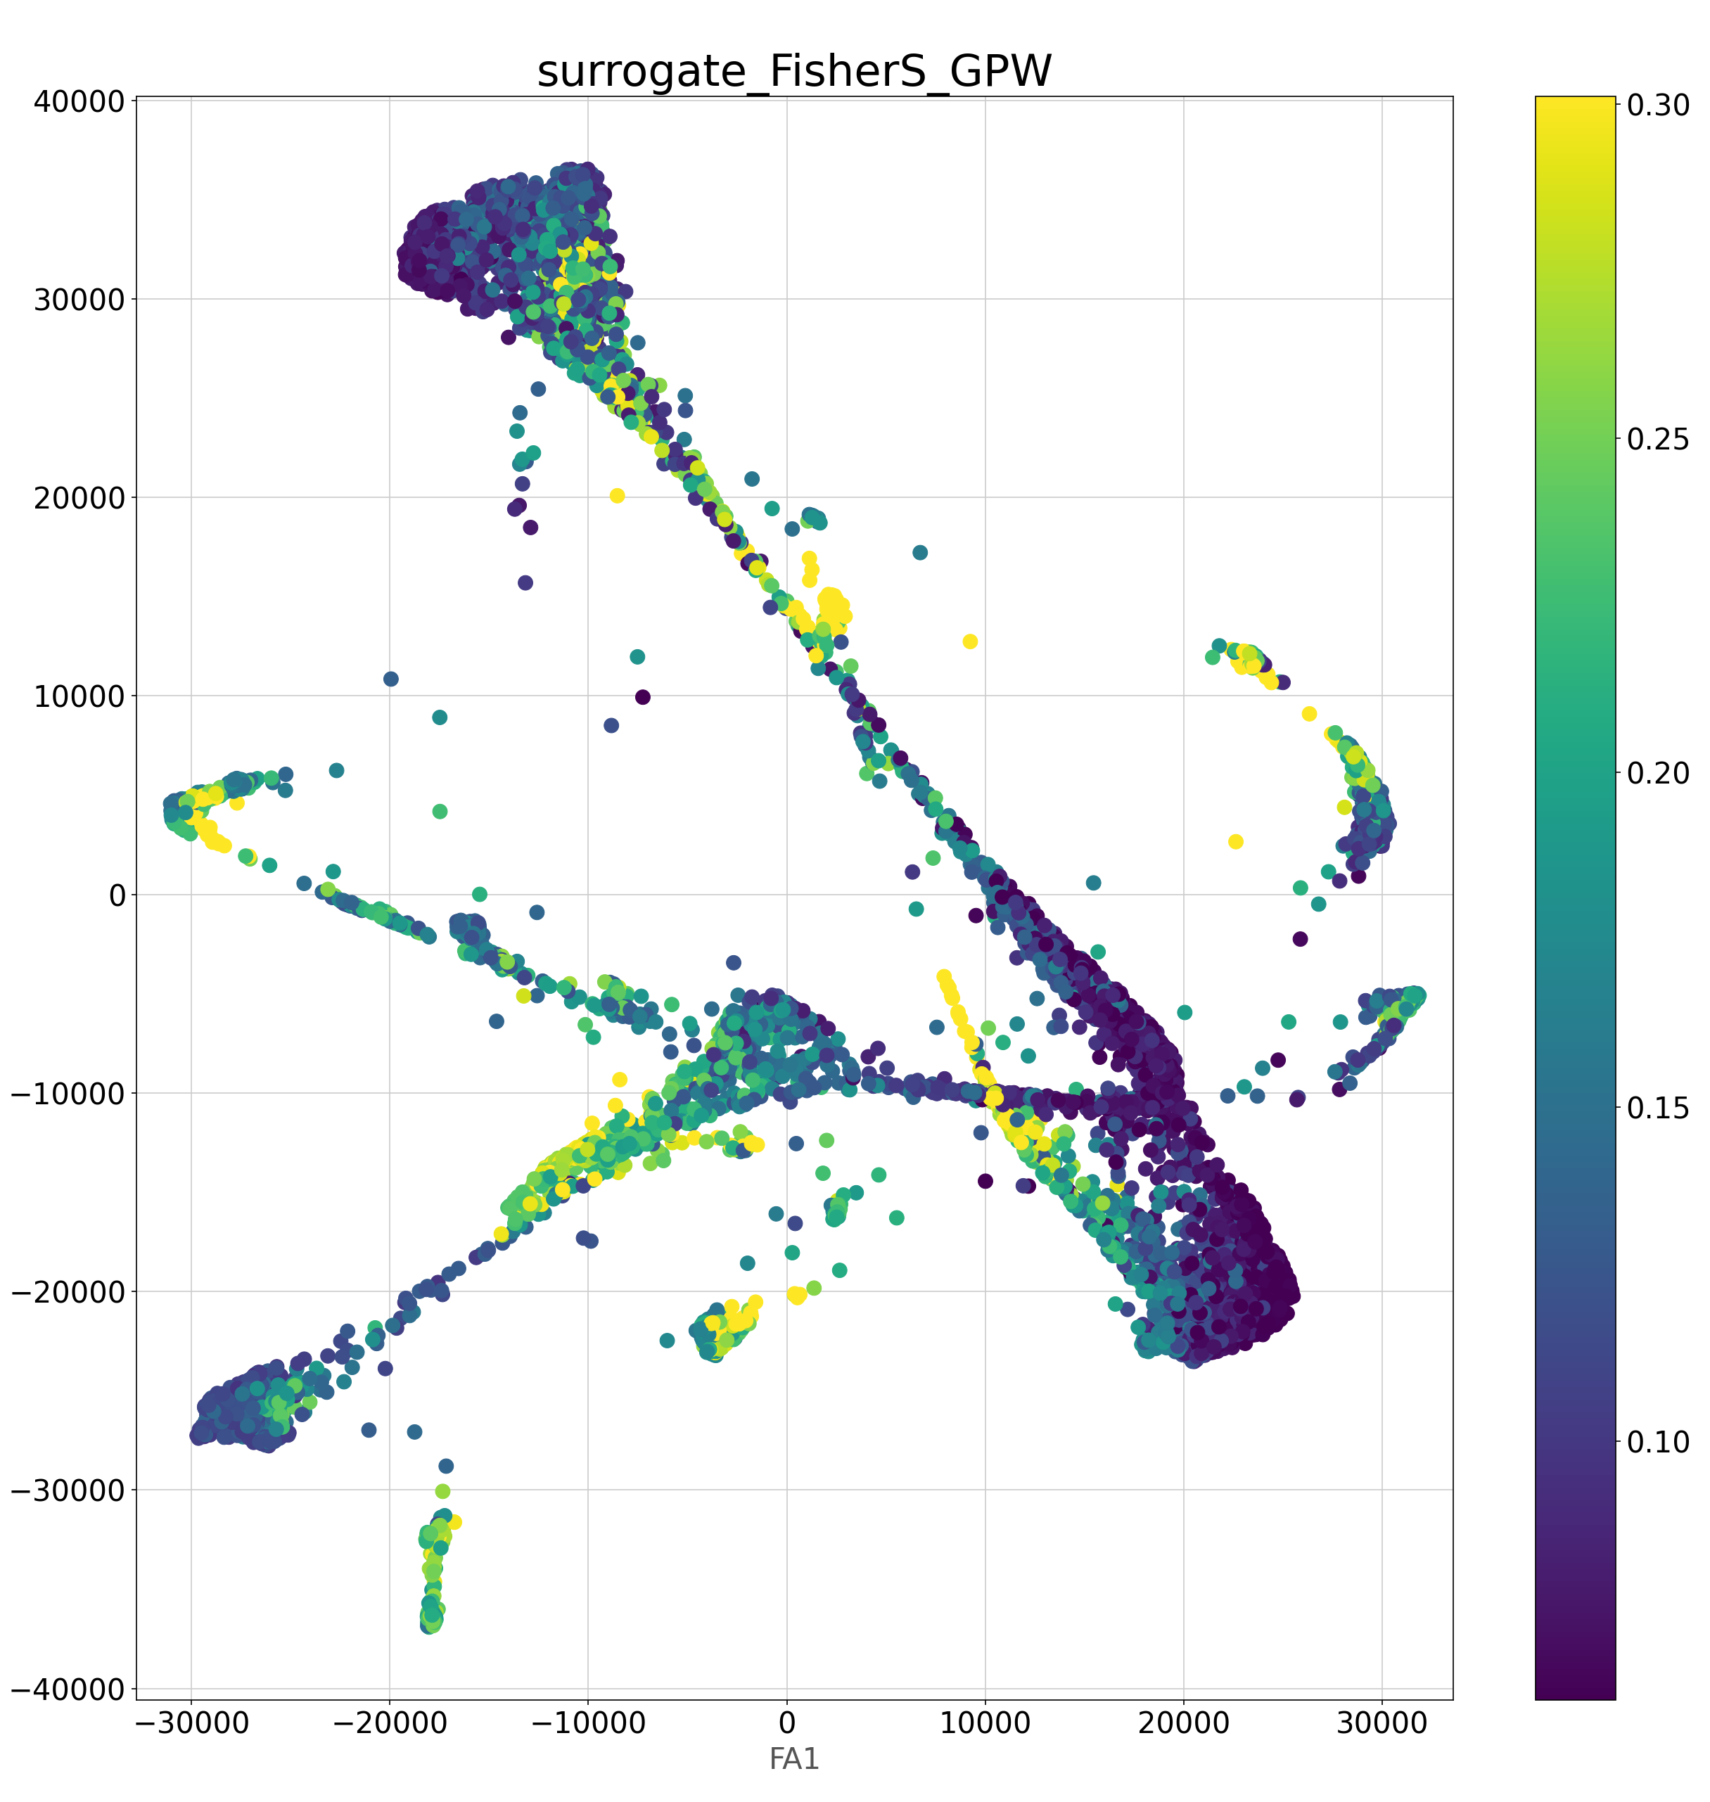
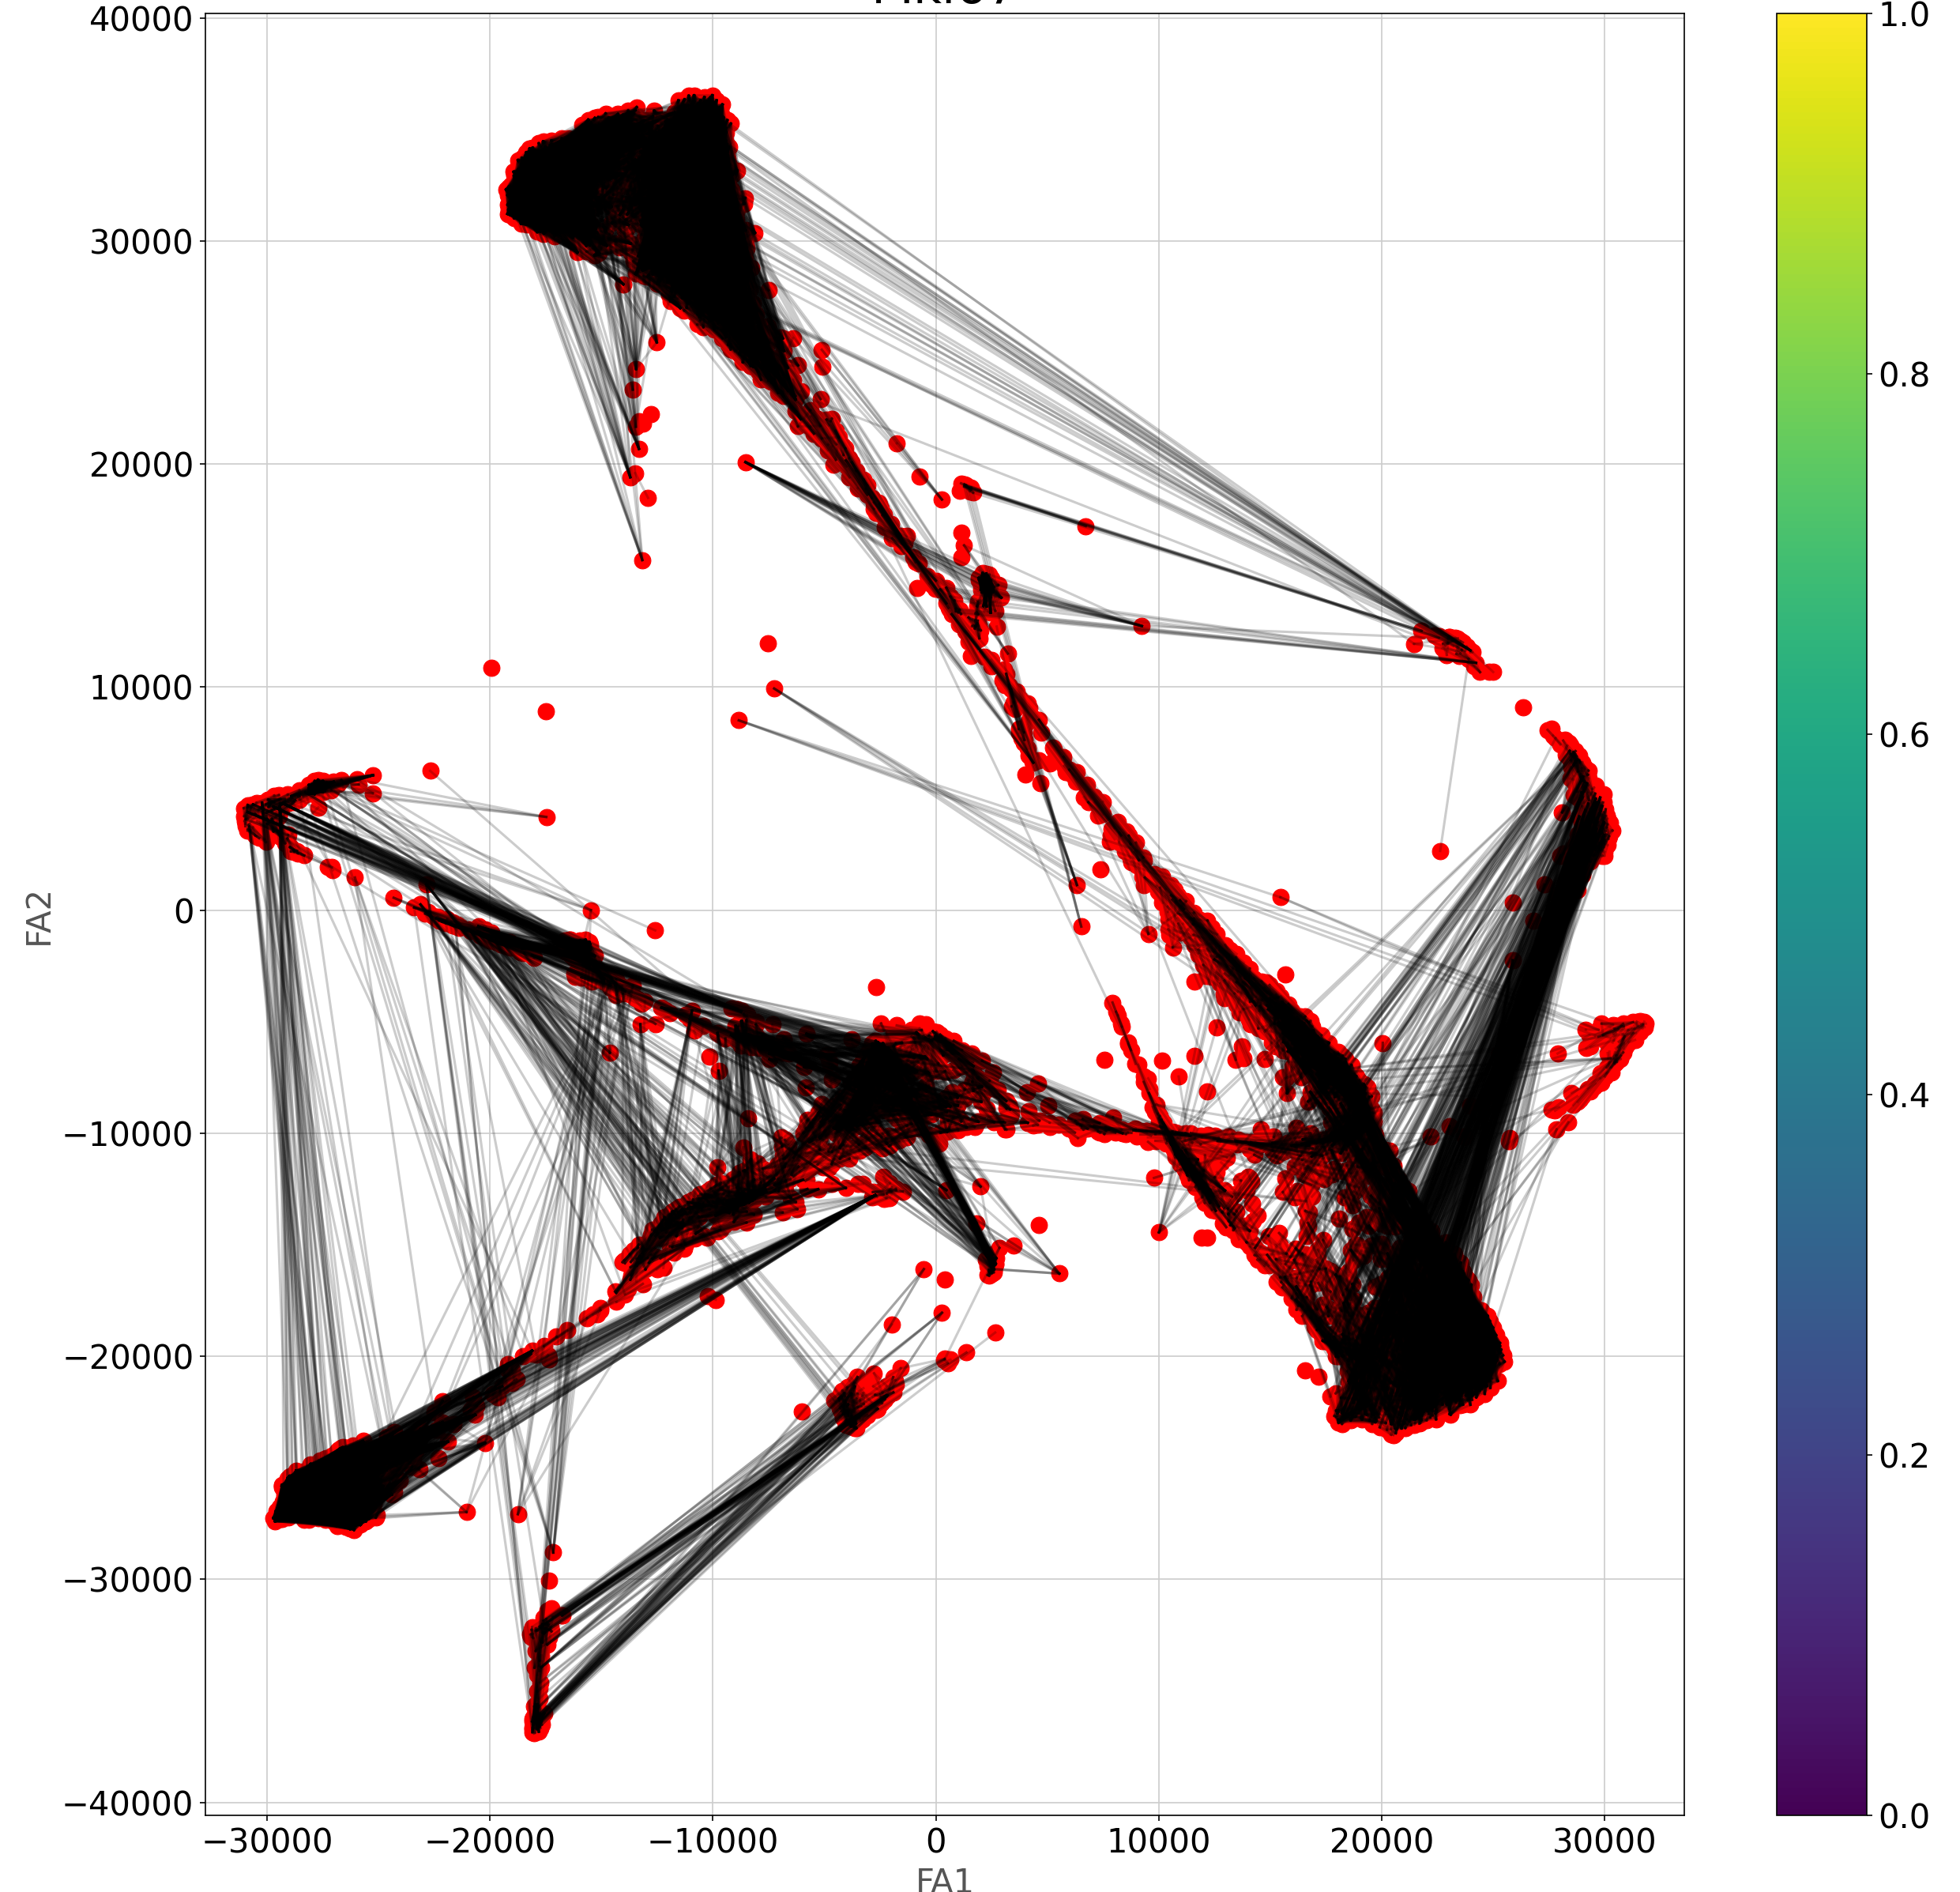
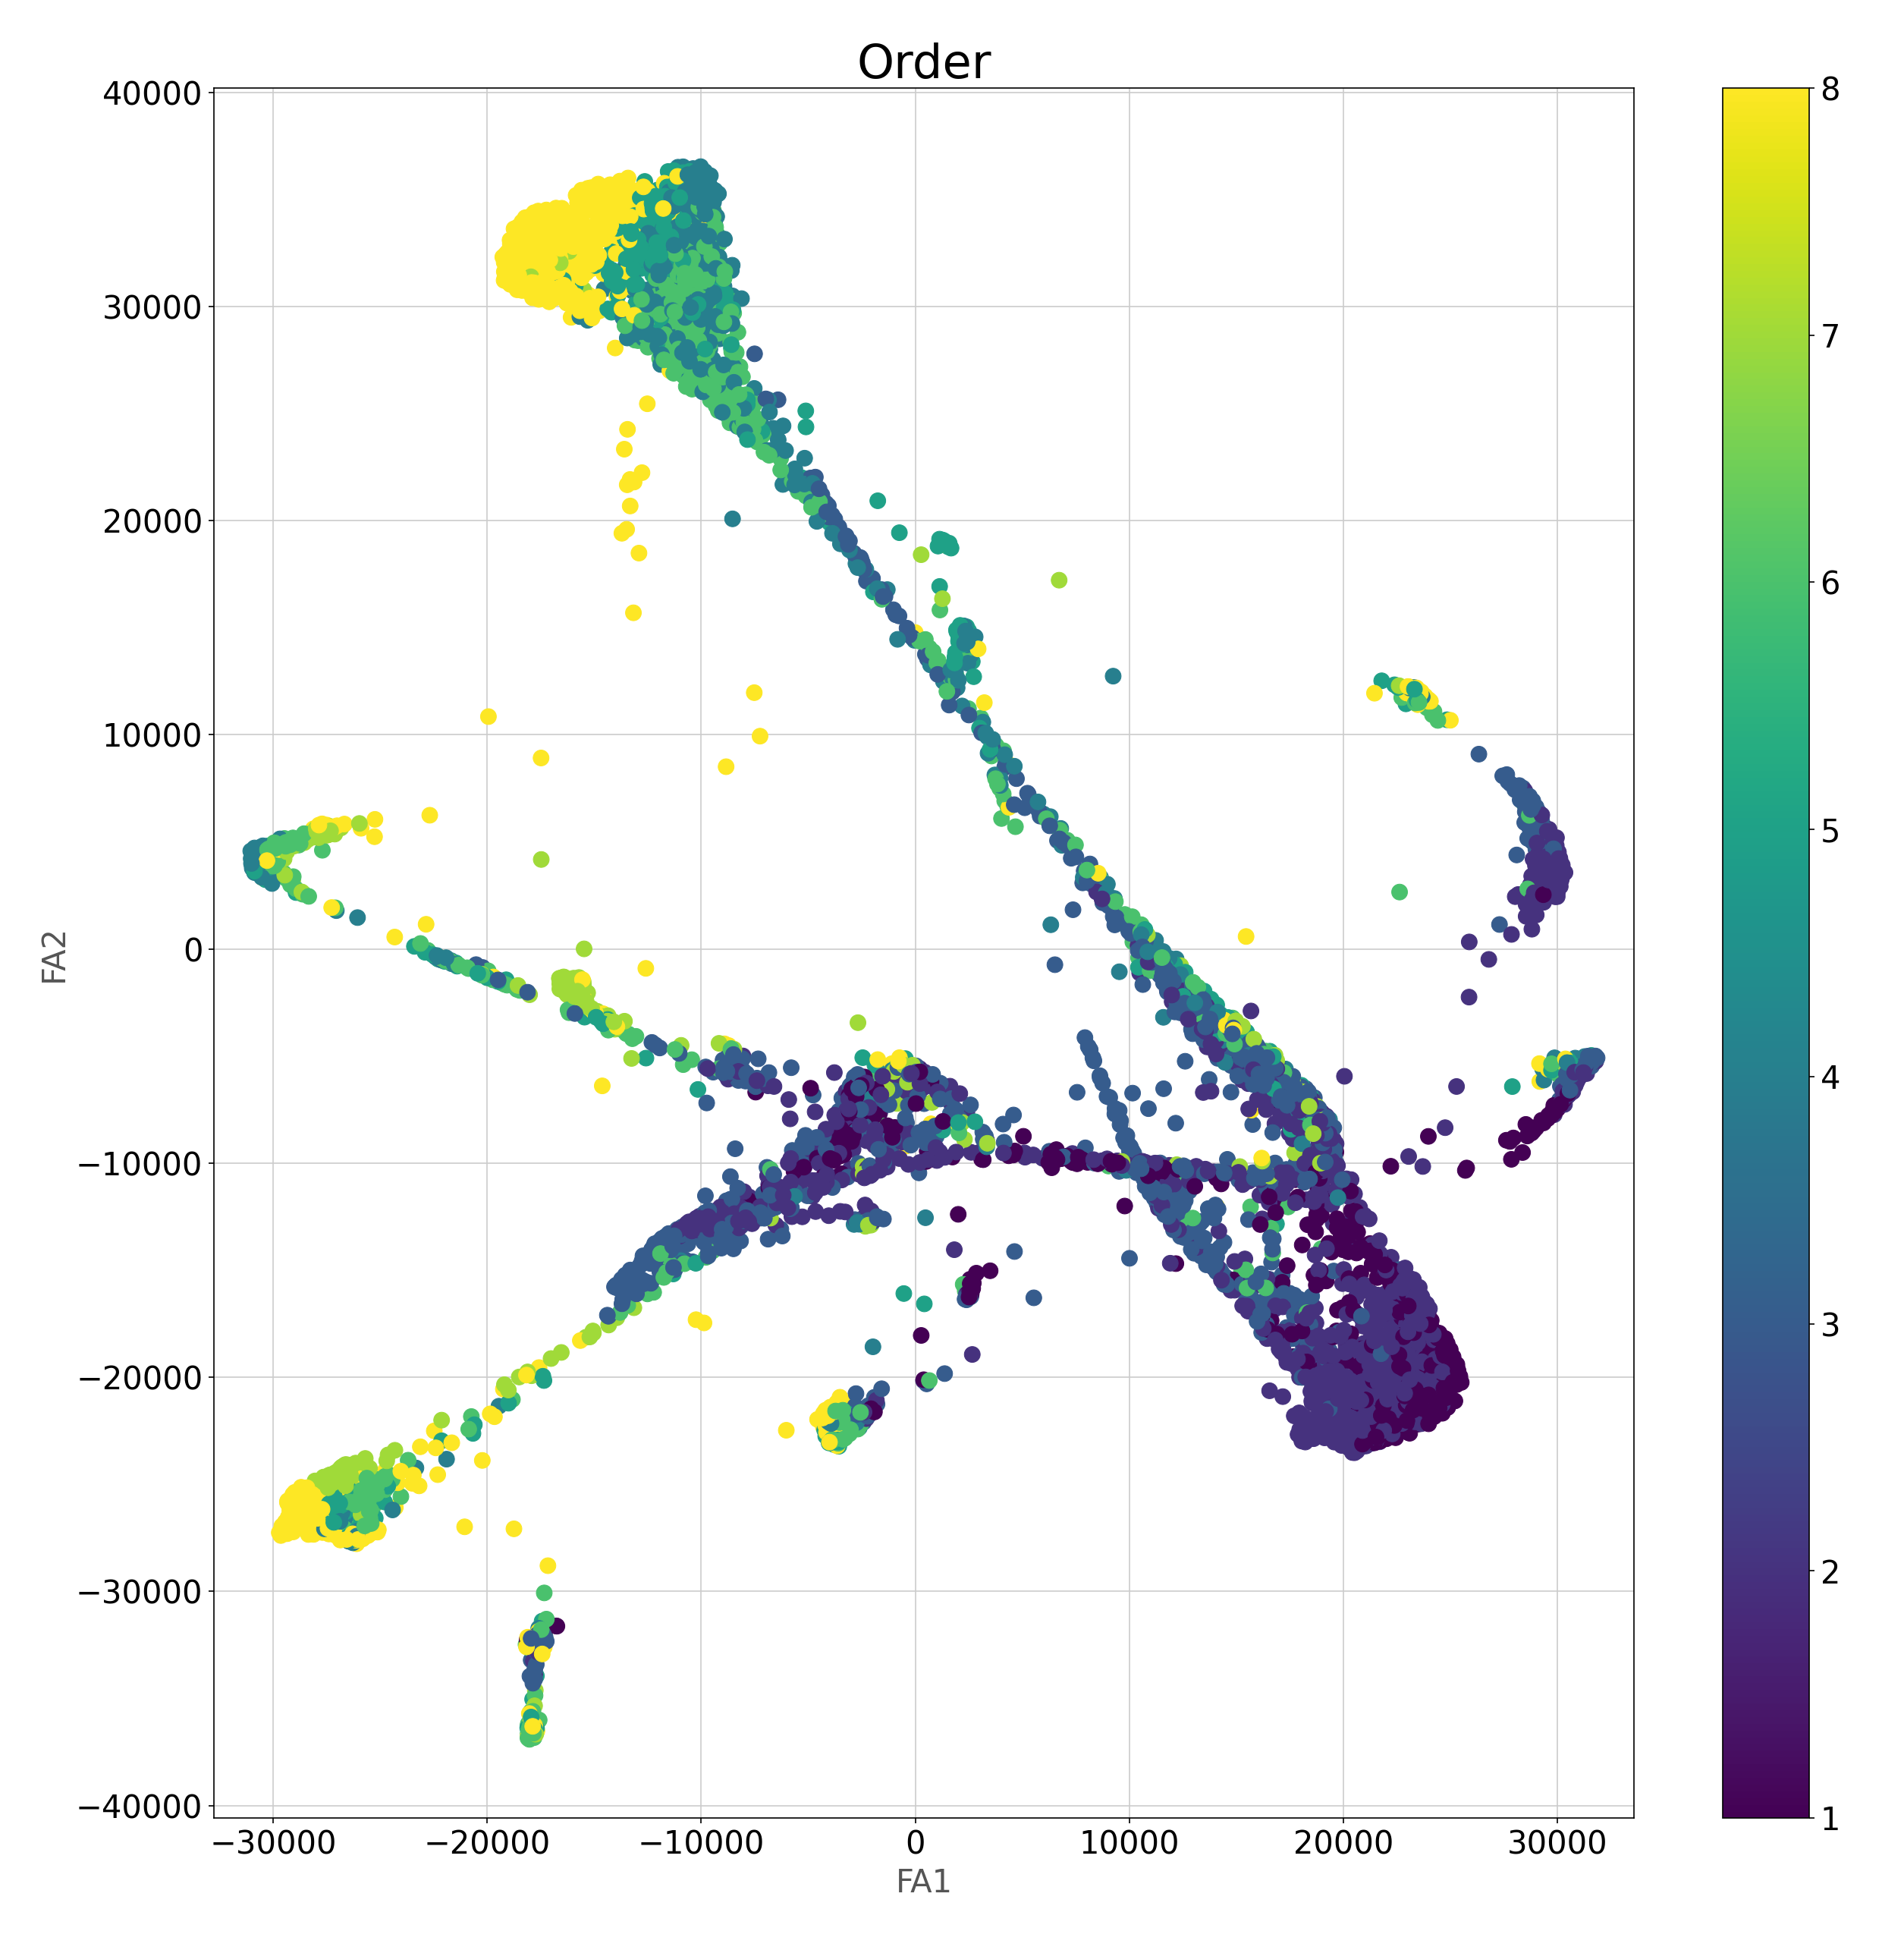
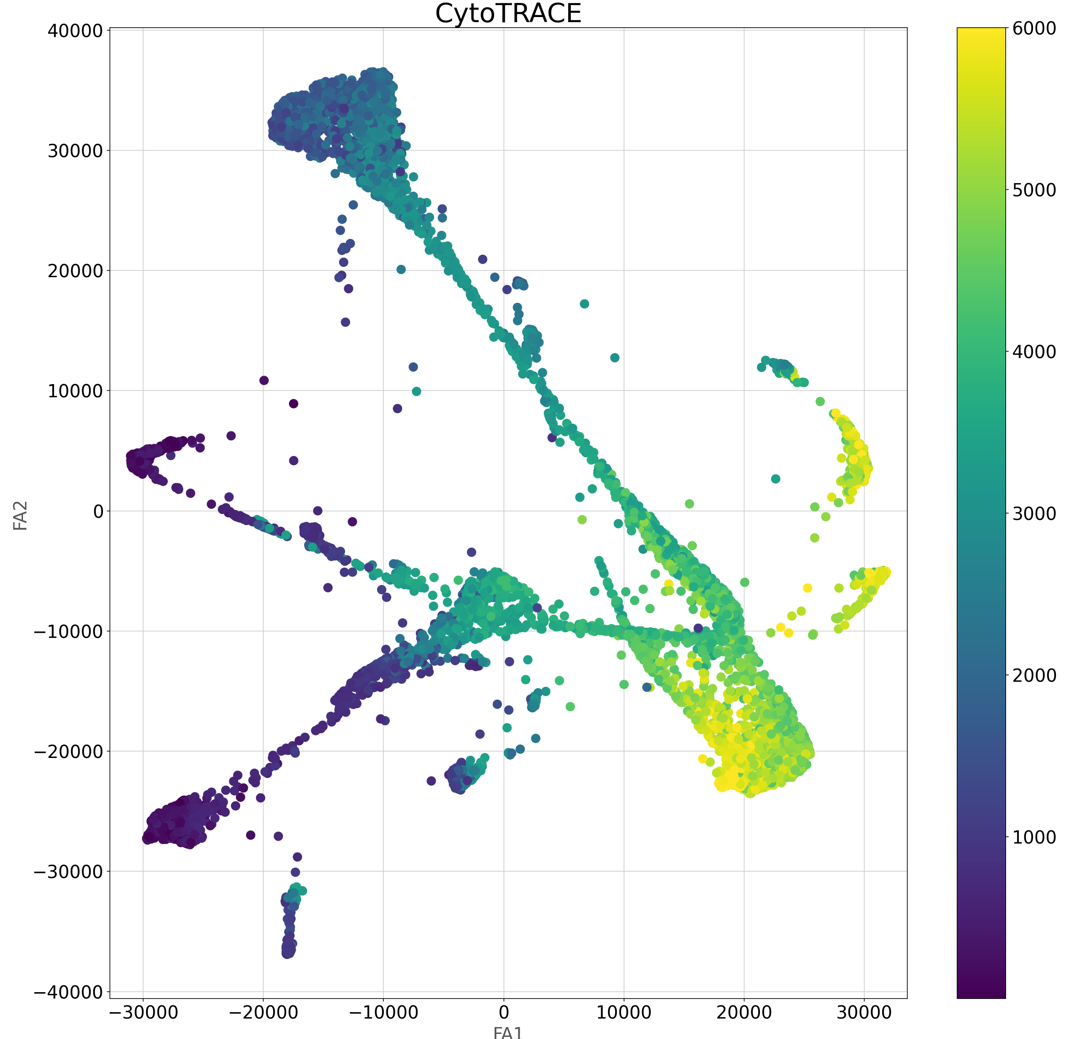

Slide 25
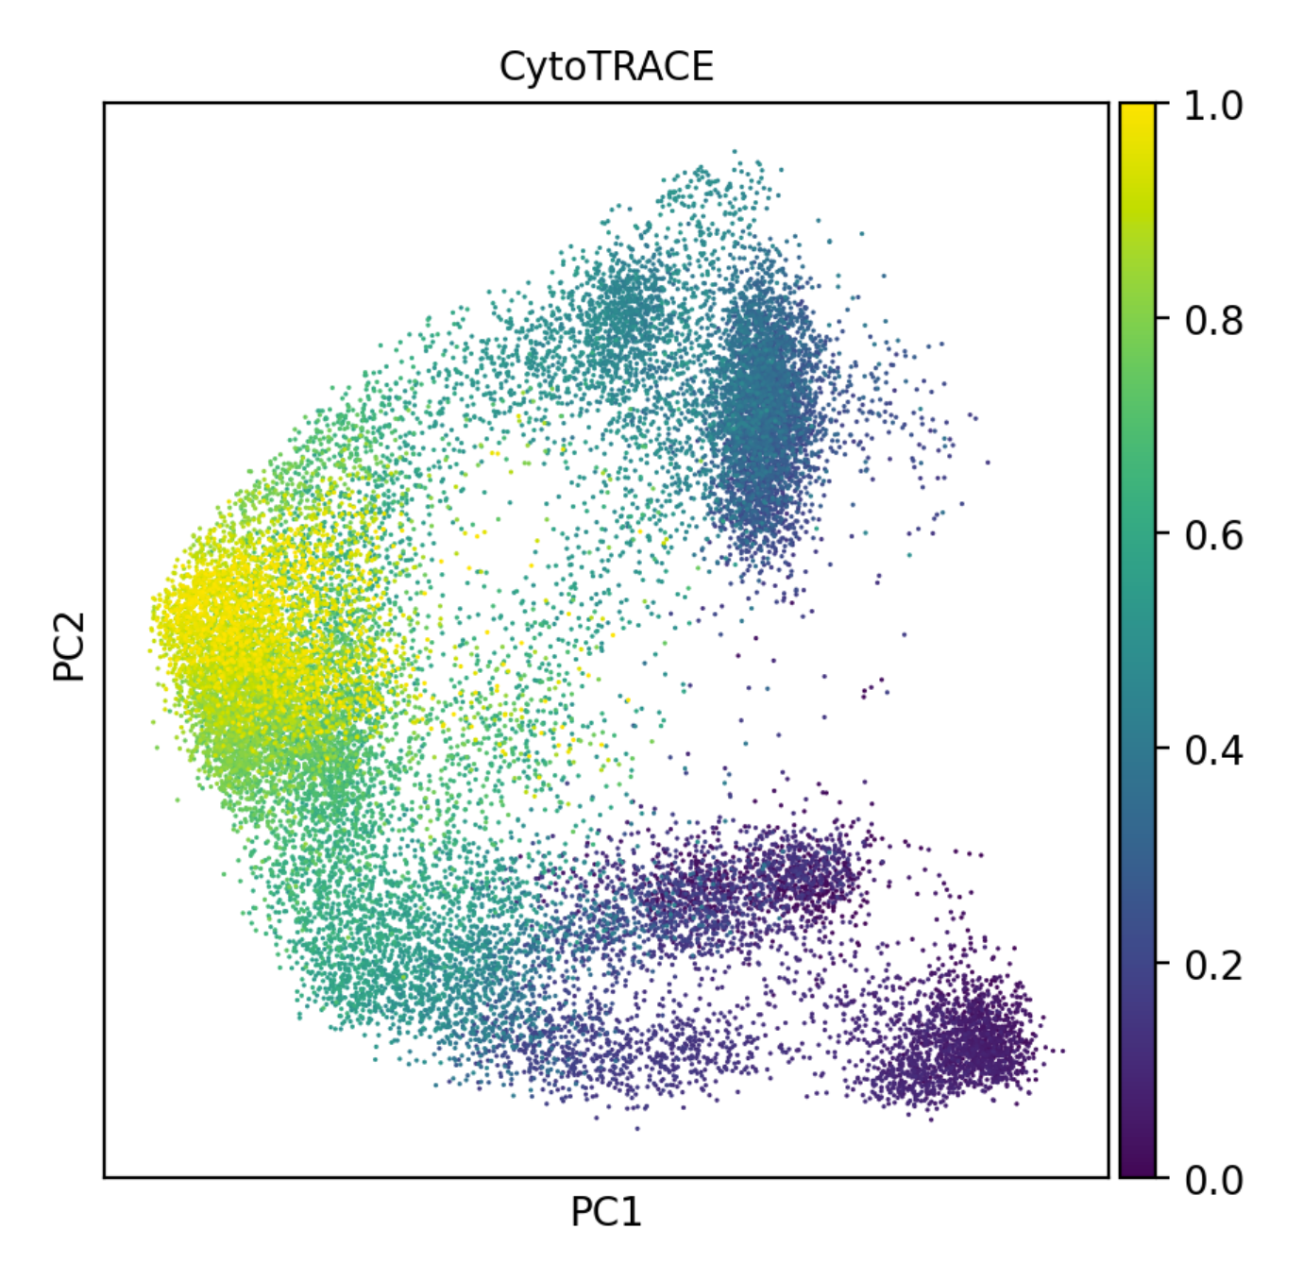


Full GSE104323 analysis

Slide 26




Slide 27







Slide 28






Slide 29







